Slide 1


Slide 2

Discover .NET MAUI
Workshop

Slide 3



About me
Digital Product Manager – FME Italy
Former Microsoft MVP – Developer Technologies
Coach - https://codingcoach.io/ Mentor
@_Codrina_

Slide 4


Workshop topics
Introduction to .NET MAUI
Create your App
MVVM & Data Binding
Navigation
Platform Specifics
Displaying Data
App Themes
Closing

Slide 5
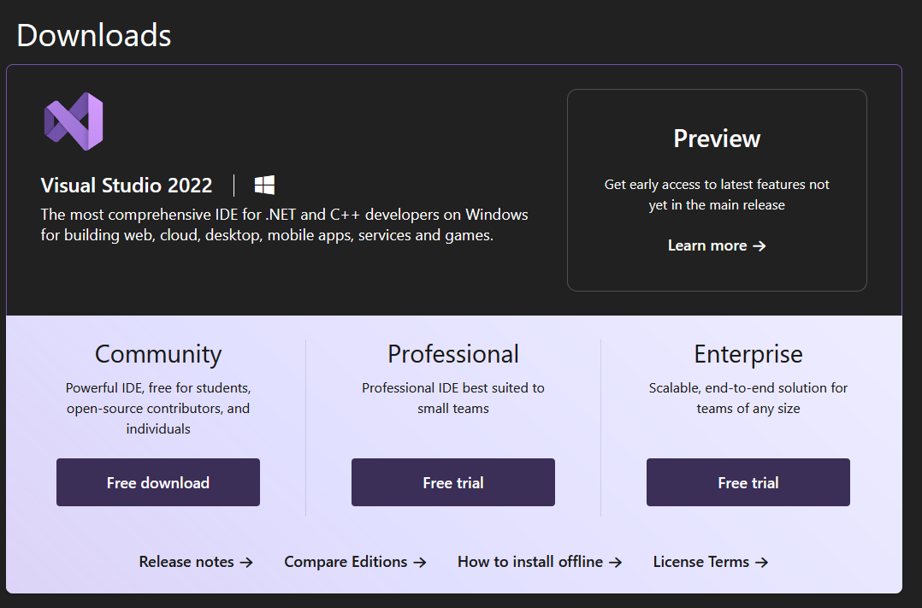
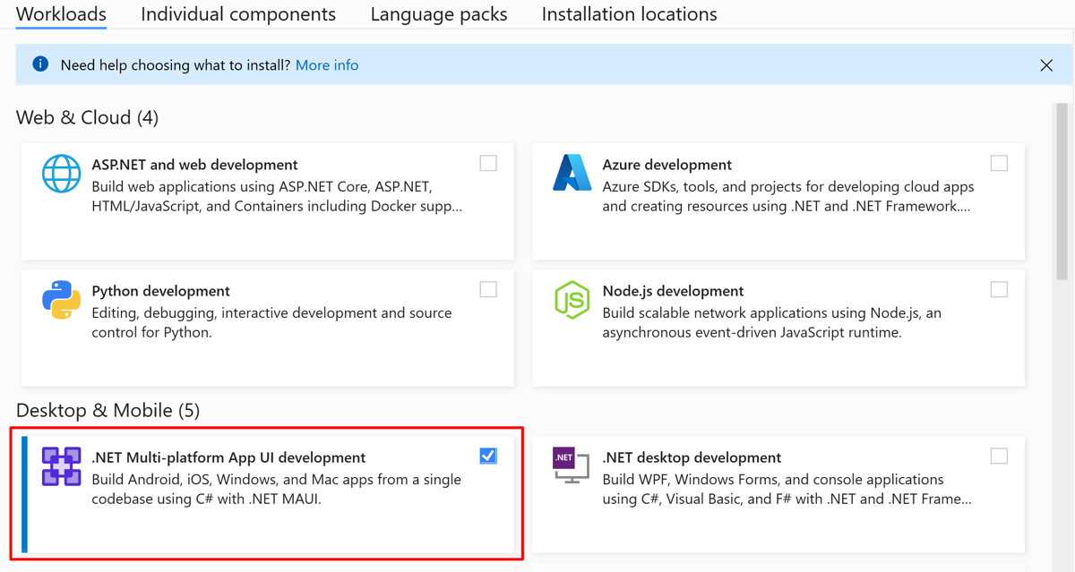
Prerequisites
Studio 2022 17.8 or greater, with the .NET Multi-platform App UI workload installed.

Slide 6
Introduction to .NET MAUI

Slide 7
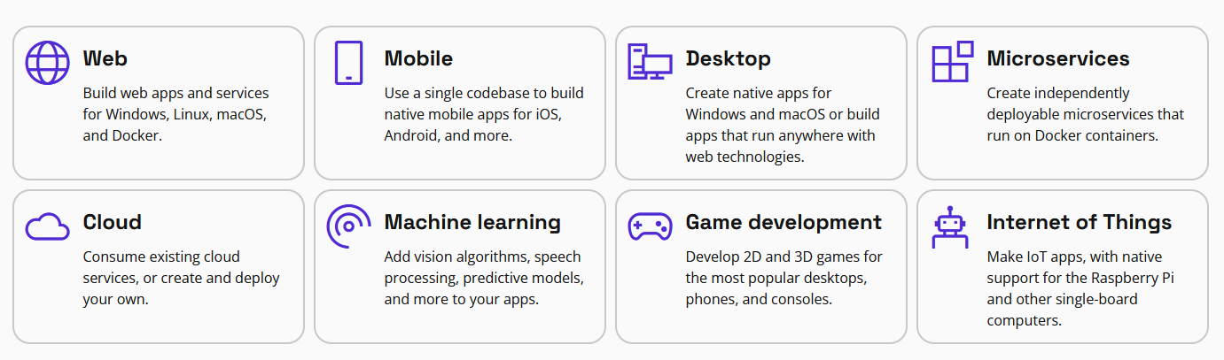


.NET
Your platform for building anything
Desktop
Web
Cloud
Mobile
Gaming
IoT
AI
Notes:
.NET is a free, cross-platform, open source developer platform for building many different types of applications.
With .NET, you can use multiple languages, editors, and libraries to build for web, mobile, desktop, games, IoT, and more.
You can write .NET apps in C#, F#, or Visual Basic.
C# is a simple, modern, object-oriented, and type-safe programming language.
F# is a programming language that makes it easy to write succinct, robust, and performant code.
Visual Basic is an approachable language with a simple syntax for building type-safe, object-oriented apps.
NET provides a standard set of base class libraries and APIs that are common to all .NET applications.
Each app model can also expose additional APIs that are specific to the operating systems it runs on, or the capabilities it provides. For example, ASP.NET is the cross-platform web framework that provides additional APIs for building web apps that run on Linux or Windows.

Slide 8









Build anything with a unified platform
.NET
Cloud
Web
Desktop
Mobile
Gaming
IoT
AI
+
+
Visual Studio
Visual Studio Code
CLI
Linux
NuGet
GitHub
Components, tools, library vendors
Windows
macOS
Tools
Operating system
Ecosystem

Slide 9




.NET Multi-platform App UI
.NET 8
Cross-platform, native UI
Single project system, single codebase
Deploy to multiple devices,
mobile & desktop
.NET MAUI
WinUI
Mac Catalyst
iOS
Android
macOS
iOS
github.com/dotnet/maui
Notes:
.NET MAUI is for developers who want to:
Write cross-platform apps in XAML and C#, from a single shared code-base in Visual Studio.
Share UI layout and design across platforms.
Share code, test, and business logic across platforms.
NET MAUI is open-source and is the evolution of Xamarin.Forms, extended from mobile to desktop scenarios, with UI controls rebuilt from the ground up for performance and extensibility. If you've previously used Xamarin.Forms to build cross-platform user interfaces, you'll notice many similarities with .NET MAUI. However, there are also some differences. Using .NET MAUI, you can create multi-platform apps using a single project, but you can add platform-specific source code and resources if necessary. One of the key aims of .NET MAUI is to enable you to implement as much of your app logic and UI layout as possible in a single code-base.

Slide 10
An open-source app platform
from Microsoft for building
modern, performant, & multi-platform
iOS, Android, macOS, & Windows apps
with C# and .NET from a
single shared codebase.

Slide 11
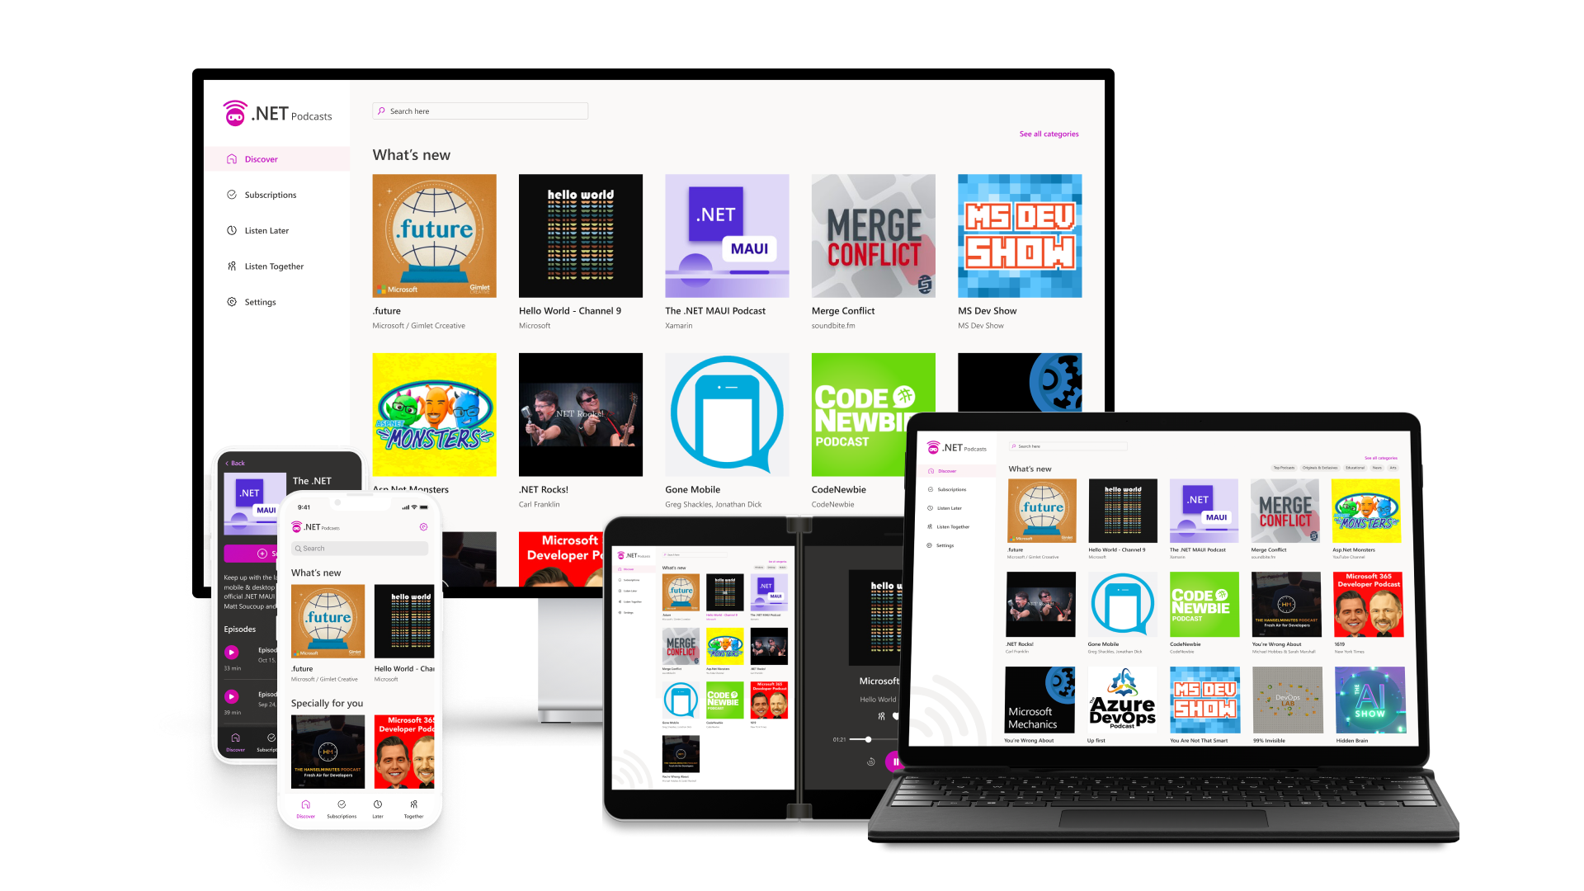
.NET Multi-platform App UI is the most productive way to develop native apps with a single codebase that perform great on any consumer device you might think of.
Sources: blog.google/products/android/android-12-beta/ ; www.imore.com/apple-earnings-call-transcripts-q1-2021 ;
Notes:
In order to reach all of these devices with beautiful app experiences, we built .NET MAUI to be the most productive way to develop native apps with a single codebase that perform great on any device. Instead of learning different stacks and languages for each device, you can use one language, one set of libraries, and one UI stack for all of them.
APIs are available directly from C# to access over 60 device platform features including things like isolated storage, sensors, geolocation, camera, and more. Use one programming language, one codebase, and one project system for all device targets with support for cross-platform resources including images, icons, splash screens, and more. .NET MAUI on Windows supports WinUI allowing these apps to use all the newest native features on supported versions of Windows 10 and 11.

Slide 12
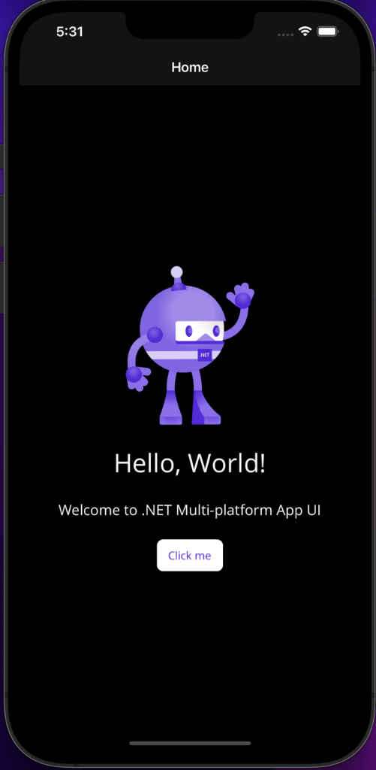
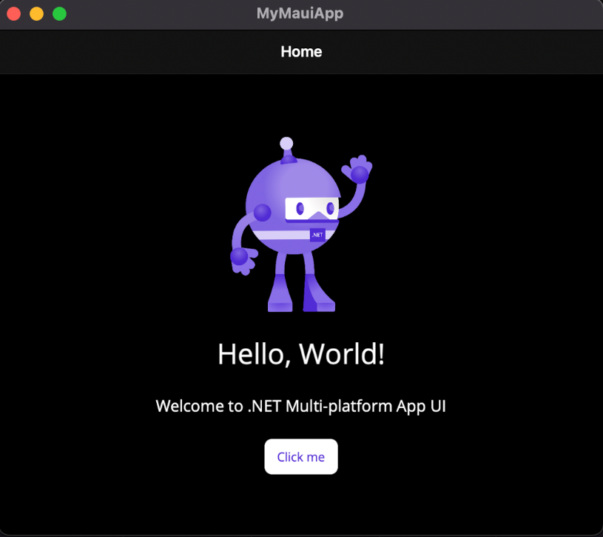
One codebase, single project, multi target
Notes:
[M]

Slide 13






.NET – A unified development platform
ECOSYSTEM
TOOLS
NuGet
Visual Studio
CLOUD
WEB
DESKTOP
MOBILE
GAMING
IoT
AI
.NET 8
GitHub
Visual Studio for Mac
COMMON BASE LIBARIES/APIs
Components, tools, library vendors
Visual Studio Code
INFRASTRUCTURE
RUNTIME COMPONENTS
COMPILERS
LANGUAGES
CLI

Slide 14
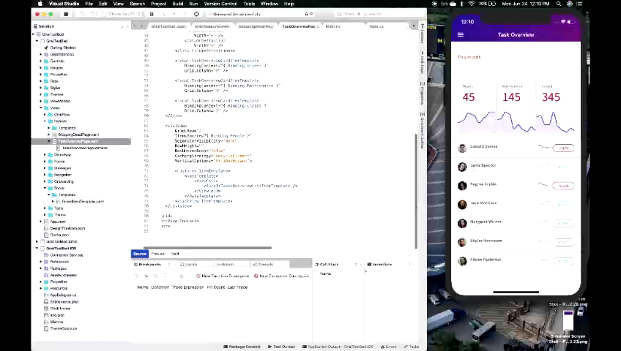
XAML Hot Reload for .NET MAUI
No code changes needed
Interact with your real data on emulators,
simulators, or devices
Intelligent and resilient
Works with custom controls, third party libraries, and more!
Notes:
.NET hot reload, so that you can modify both your XAML and your managed source code while the app is running, then observe the result of your modifications without rebuilding the app. For more information, see .NET hot reload.

Slide 15


.NET MAUI App Architecture
C#
C#
C#
C#
Shared Code
UI, Resources, Platform Features, & Business Logic

Slide 16




Productive environment
Maximize code reuse
Native performance & integrations
Expansive ecosystem

Slide 17

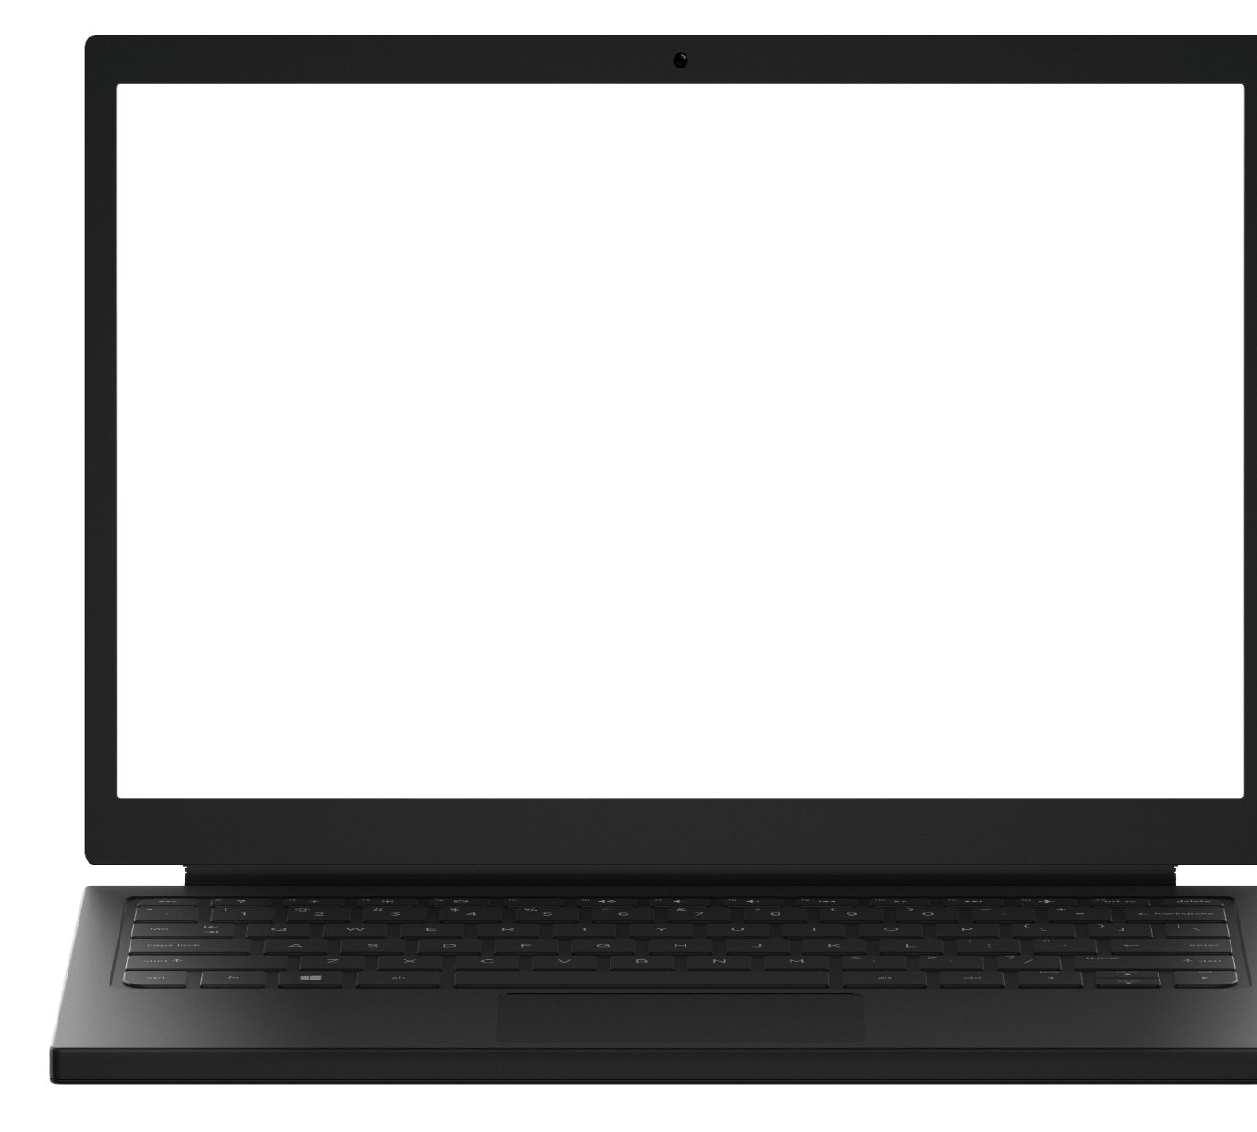
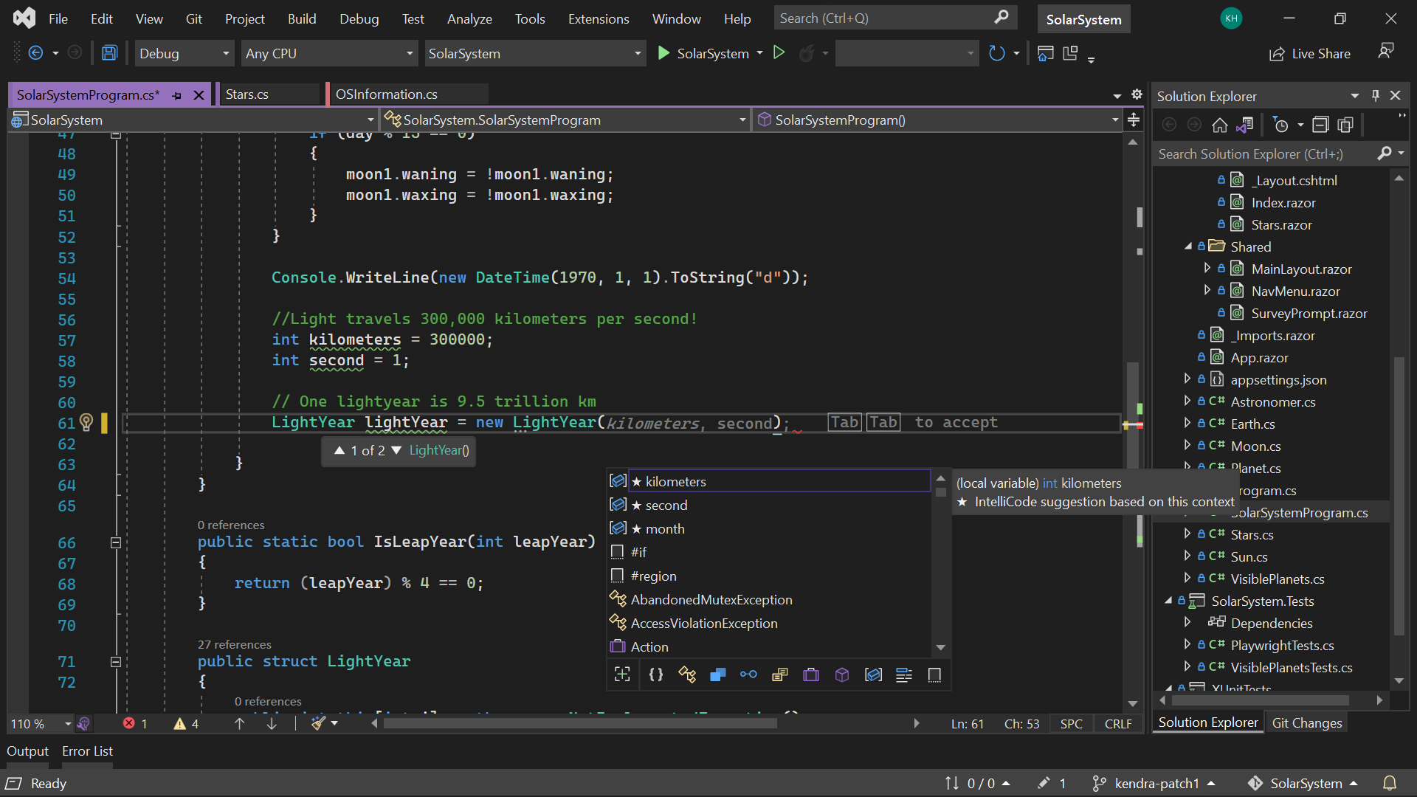
Visual Studio 2022
Modern development
Build innovative, modern apps using .NET 6, GitHub and Azure with integrated tooling
Personal and team productivity
Live Share, Hot reload everywhere, Web live preview, IntelliCode, enhanced debugging and testing tools
Scale to projects of any size
An optimized, modern UI built on 64-bit architecture to support the largest, most complex codebases and workflows
VisualStudio.com/download

Slide 18

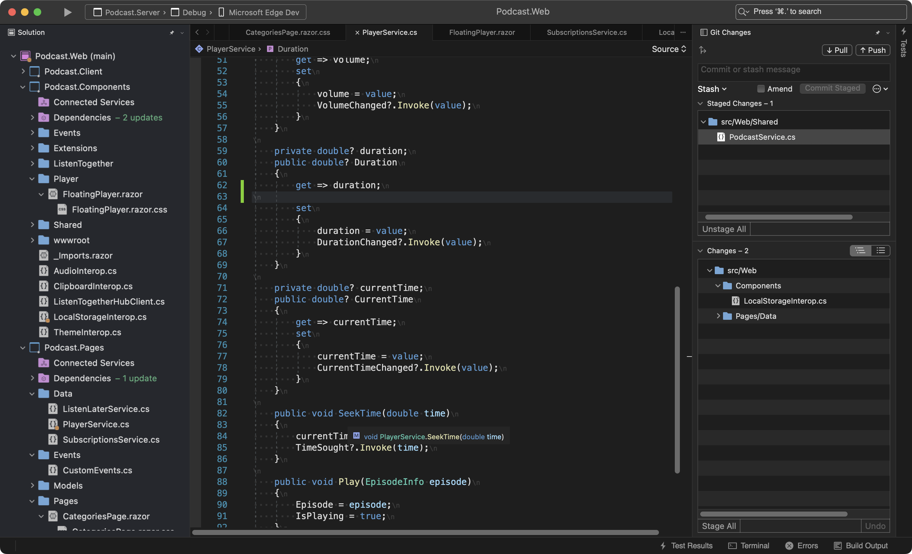
Visual Studio 2022 for Mac
Fast and Fluid
Focused on performance with over 100 user reported issues fixed; running on .NET 6 and with native support for Apple’s M1 processor
Modern macOS UI
A rewritten UI, using native macOS Cocoa APIs. With native theming, full screen support, and macOS accessibility tooling.
Support for .NET 6
Build for the web, cloud, and (soon) mobile, using .NET 6.
https://aka.ms/vsmac-preview

Slide 19

Modern Patterns
MVVM
Provide Values
View Bound to ViewModel
Model
ViewModel
View
Updates
Triggers Commands
MVU
ReactiveUI
Generated View
View
User Action
Model
Message
Reducer
New Model
Notes:
As you know Xamarin.Forms support MVVM (model-view-viewmodel) and RxUI (ReactiveUI) patterns. In addition to those, .NET MAUI will support MVU (model-view-update) and Blazor development patterns.
MVU This pattern provides a unified way to build cross-platform native front ends from a single code base. It also allows us to write UI code and logic in C# as shown below.
MVVM(Model View ViewModel) MVVM is the default built in architecture design pattern in the xamarin.Forms framework. The UI in MVVM is Mutable. Which make managing the state difficult and cause many issues. It consists of three parts. • Model- The definition of data • View- The User Interface for user to interact with the app • ViewModel- The ViewModel stays in between the View and Model. It have all the business logic and presentation logic. The MVVM enable to keep the UI code, Logic and Data separate. Thus it help in easy maintenance. You can learn more about MVVM at https://docs.microsoft.com/en-us/xamarin/xamarin-forms/enterprise-application-patterns/mvvm
ReactiveUI ReactiveUI is a framework which enables use of Reactive Programming over MVVM design pattern. Reactive Programming is done using Reactive Extensions. The Reactive Extensions (Rx) is a library for composing asynchronous and event-based programs using observable sequences and LINQ-style query operators. ReactiveUI make mutable state managable. DynamicData is part of ReactiveUI which makes managing any kind of data very efficient. The definition given at reactiveui.net is “An advanced, composable, functional reactive model-view-viewmodel framework for all .NET platforms!”. The Reactive code is concise and testable. You can learn about it at https://www.reactiveui.net/
MVU( Model View Update) MVU is a Functional Reactive Programming, architecture design pattern. In MVU UI is immutable. So you have to rebuild your UI, every time you wanted to update a property. Immutability is the property of Funtional Programming. C# does support Functional programming paradigm. C# is taking it further with C# 9 and dot net 5 release in November 2020. In this setup the UI and business login is written in same language e.g C#. The flow of data is unidirectional. It is Good fit for hot reload of the application. You don’t need to learn XAML for developing UI instead develop complete application in one language.
MVU This pattern provides a unified way to build cross-platform native front ends from a single code base. It also allows us to write UI code and logic in C# as shown below.

Slide 20
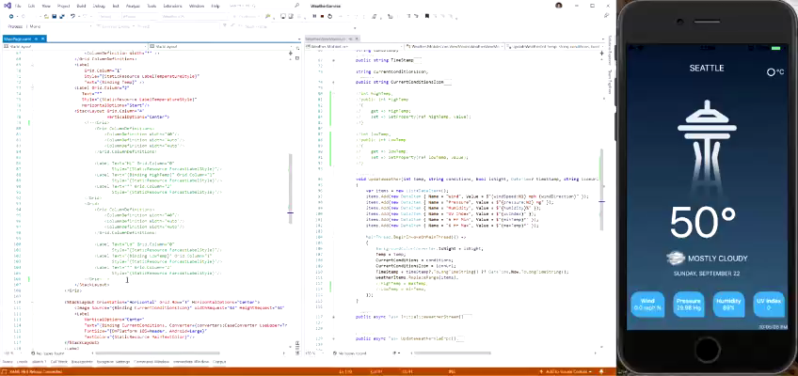
.NET MAUI Hot Restart
Fast rebuild and redeploy of your application
Debug on your iPhone directly from your PC
Works great with Hot Reload!

Slide 21
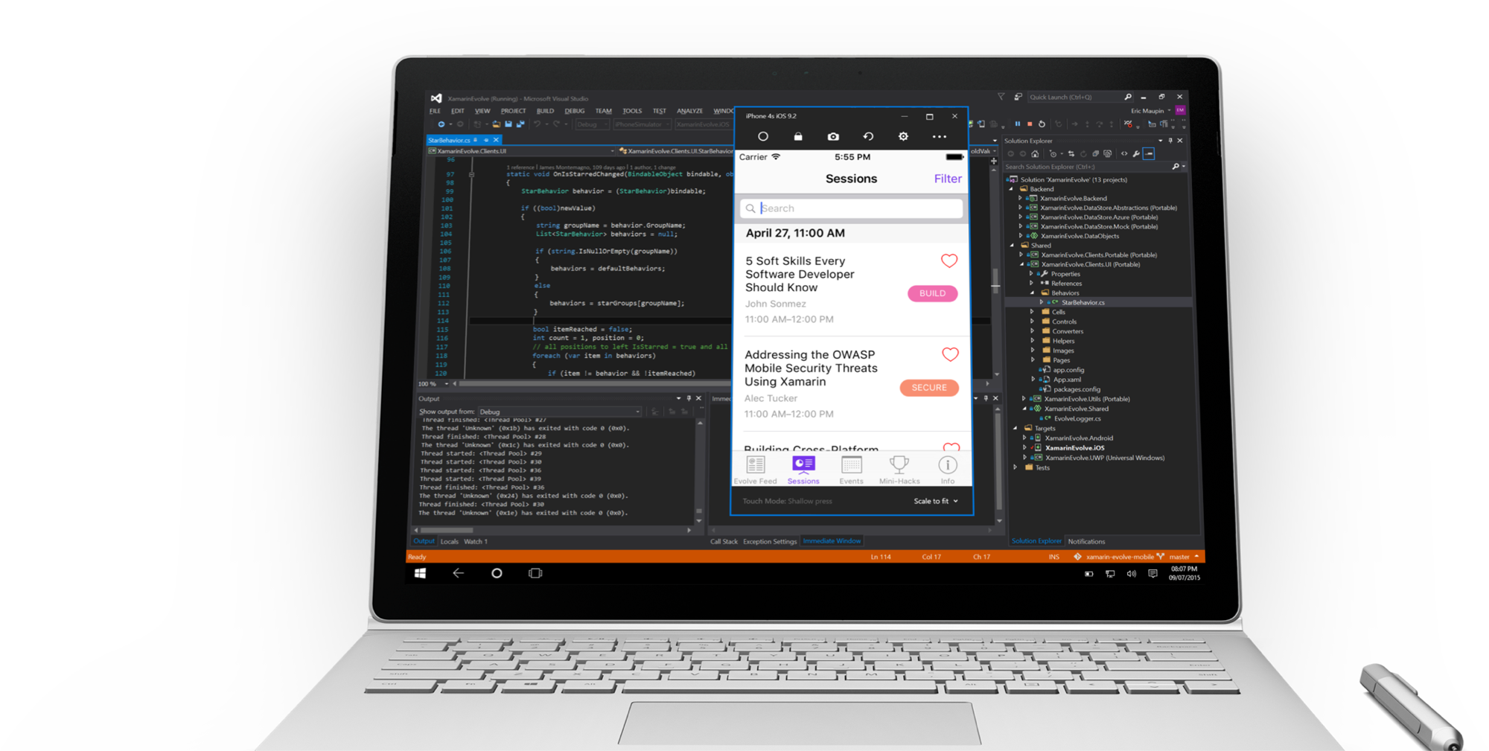
Visual Studio iOS Simulator Remoting
Multi-Touch Enabled
Pressure Sensitive
Super Fast
Rotate, screenshots,
location changes
Never leave VS

Slide 22
Cross-Platform UI

Slide 23




UIActivityIndicator
ProgressBar
UISlider
SeekBar
ActivityIndicator
Slider

Slide 24
Controls
CarouselView
CollectionView
ListView
Picker
TableView
IndicatorView
ProgressBar
ActivityIndicator
Editor
Entry
CheckBox
DatePicker
Slider
Stepper
Switch
TimePicker
Button
ImageButton
RadioButton
RefreshView
SearchBar
SwipeView
BlazorWebview
Border
BoxView
Frame
GraphicsView
Image
Label
ScrollView

Slide 25

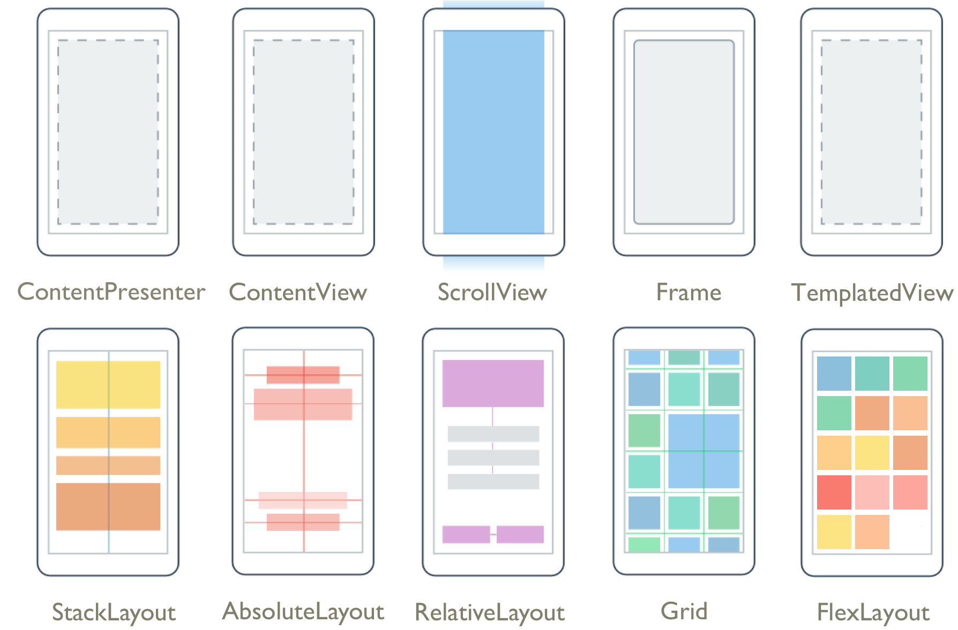
Layouts
Pages
Content
Flyout
Navigation
Tabbed

Slide 26
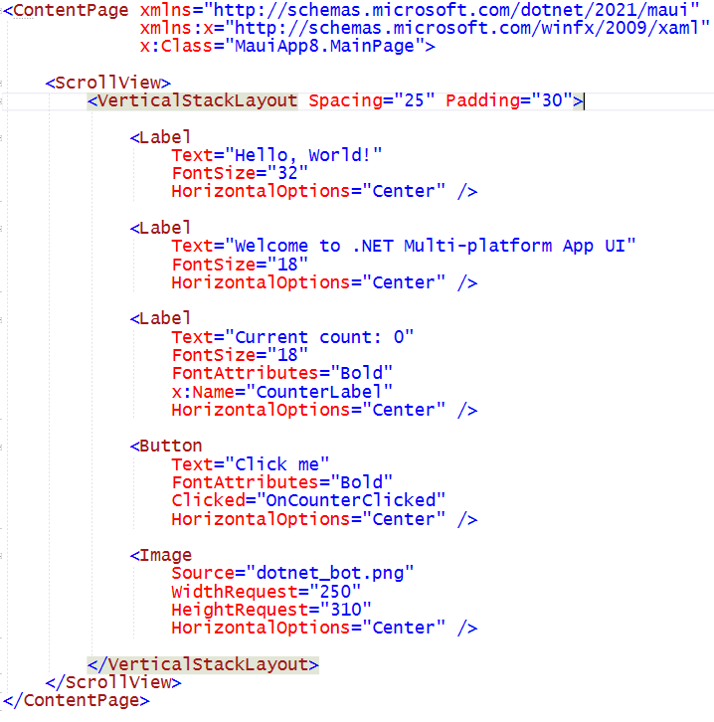
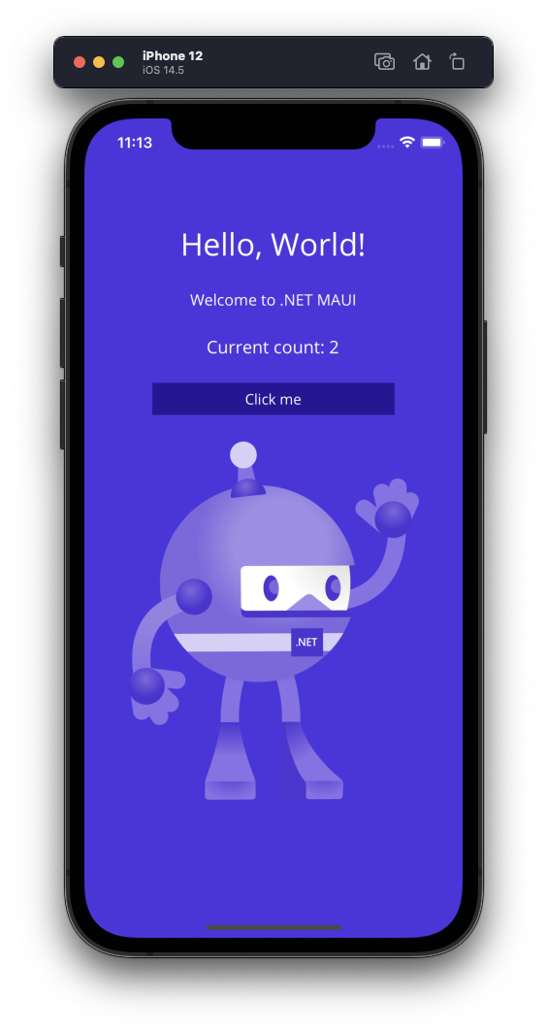
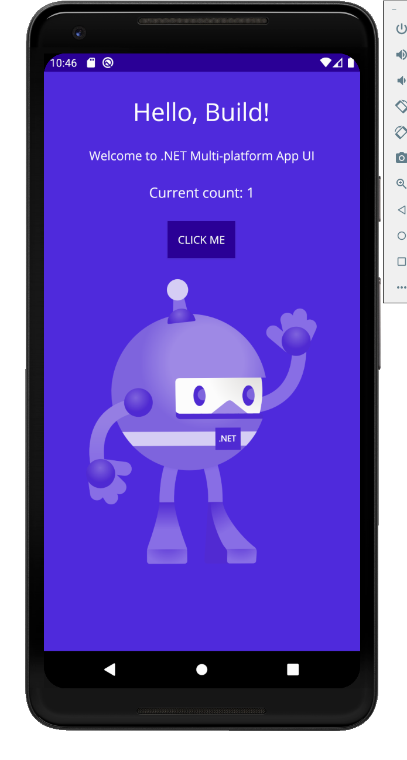
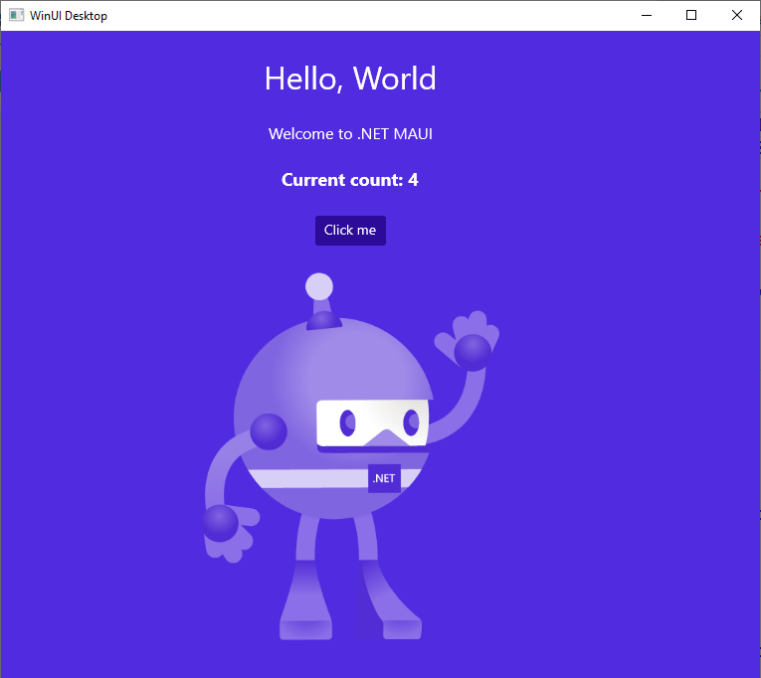
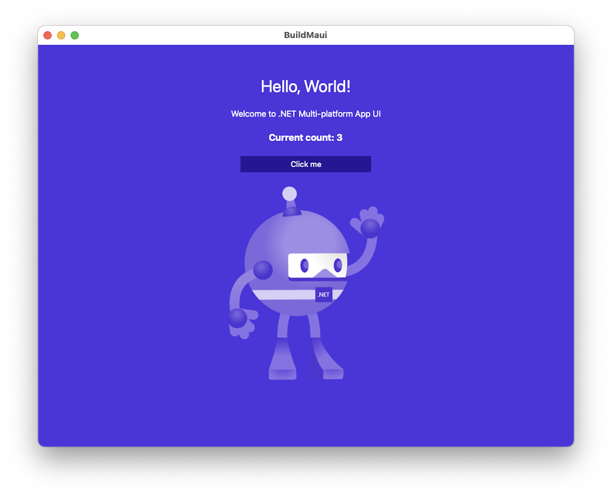

Slide 27
Platform API Access

Slide 28
iOS
MapKit
UIKit
SiriKit
ARKit
CoreML
System.Net
System
System.IO
System.Linq
System.Xml
System.Data
System.Windows
System.Numerics
System.Core
System.ServiceModel
C#

Slide 29
Android
Fingerprint
Bluetooth
Picture-in-Picture
Geolocation
NFC
System.Net
System
System.IO
System.Linq
System.Xml
System.Data
System.Windows
System.Numerics
System.Core
System.ServiceModel
C#

Slide 30

Cross-Platform APIs
Sms
Secure Settings
Preferences
Flashlight
Clipboard
Gyroscope
Magnetometer
Geolocation
Phone Dialer
Device Display Info
Email
Device Info
Battery
Compass
Accelerometer
Screen Lock
Data Transfer
Text to Speech
Geocoding
File System
Connectivity
Vibration

Slide 31
Geolocation Example
// Get cached location, else get real location.
var location = await Geolocation.GetLastKnownLocationAsync();
if (location == null)
{
location = await Geolocation.GetLocationAsync(new GeolocationRequest
{
DesiredAccuracy = GeolocationAccuracy.Medium,
Timeout = TimeSpan.FromSeconds(30)
});
}

Slide 32
Geolocation Example
// Register service
builder.Services.AddSingleton<IGeolocation>(Geolocation.Default);
// Inject service
IGeolocation geolocation;
public MyViewModel(IGeolocation geolocation)
{
this.geolocation = geolocation;
}

Slide 33
Performance

Slide 34
Built on trusted technology
ARM BINARY
IL + JIT
.NET
.NET
AOT
.APP
Compile and Link
.APK
C#
C#
Runs natively
Runs natively
Bindings
Bindings
.NET for iOS does full Ahead Of Time (AOT) compilation to produce an ARM binary for Apple’s App Store.
.NET for Android takes advantage of Just In Time (JIT) & Ahead of Time (AOT) compilation on the Android device.

Slide 35
Full App Platform
✓ 40+ Pages, layouts, and controls
(Build from C# or XAML)
✓ Two-way data binding
✓ Navigation
✓ Visual State Manager
✓ Animation API
✓ Dependency Service
✓ Messaging Center
✓ CI/CD Support
✓ Hybrid Development with Blazor
✓ Platform API Access
✓ Images, Icons, Fonts, Splash Screens
✓ Custom & Default Themes
C#
C#
C#
C#
Shared Code
UI, Resources, Platform Features, & Business Logic

Slide 36




.NET MAUI
.NET 6
Cross-platform, native UI
Single project system, single codebase
Cross-platform, device API access
Native compilation, native performance
Deploy to multiple devices, mobile & desktop
.NET MAUI
WinUI
Mac Catalyst
iOS
Android
macOS
iOS
github.com/dotnet/maui

Slide 37
What about web developers?

Slide 38








Web development with .NET
ASP.NET Core
Blazor
JS

Slide 39



Blazor is flexible. You have choices.
Blazor Server
Blazor WebAssembly
Blazor
Blazor
DOM
SignalR
.NET
Razor Components
DOM
.NET
Razor Components
WebAssembly

Slide 40














Blazor

Slide 41




Blazor Hybrid:
+

Slide 42
Hybrid Architecture - .NET MAUI & Blazor
C#
C#
C#
C#
C#
Shared Blazor Components
Shared Business Logic

Slide 43
Hybrid app benefits
Reuse existing web development skills and code
Access to all the native platform capabilities of the device
Mix native & web UI
Reduce app development time
Ship seamlessly to app store or internal distribution

Slide 44
.NET brings rich choices for devs and dev teams
Blazor
Blazor Hybrid
(Blazor + .NET MAUI)
.NET MAUI
Reach
Power
Site
PWA
Native App
with WebView
Native App
Web
Hybrid
Native

Slide 45
Questions Time
@_Codrina_

Slide 46
Create your app

Slide 47
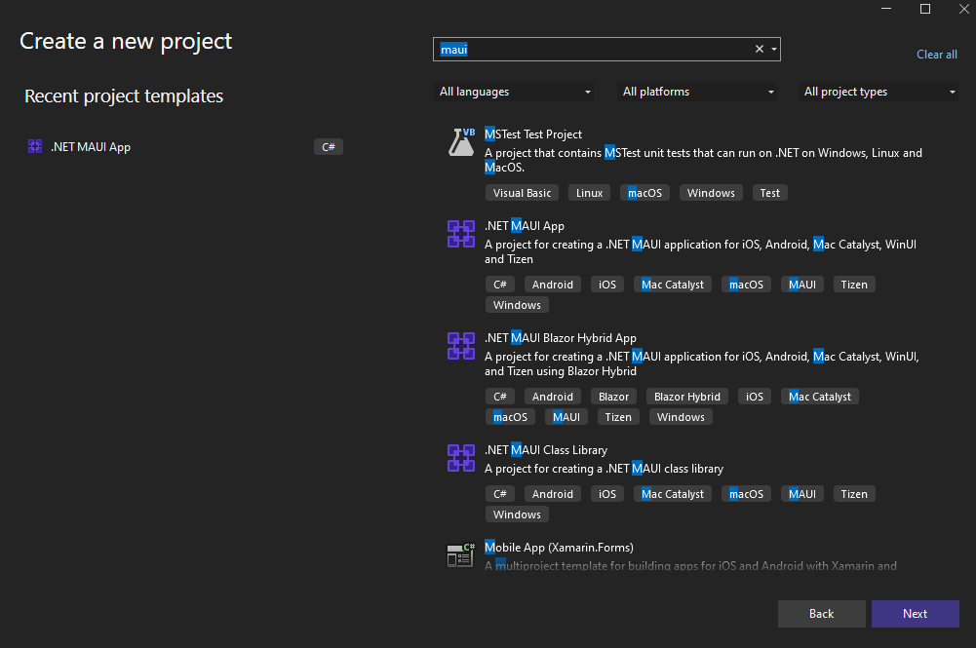
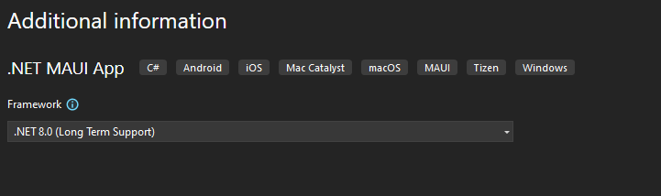

Slide 48
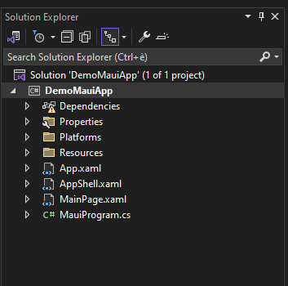
Project Structure
One Single Project that hosts all of the source code for the project including UI, platform code, shared resources, and more

Slide 49
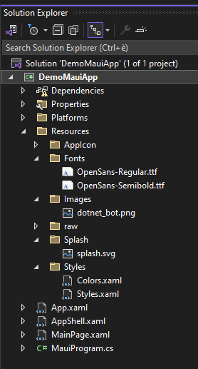
Cross-Platform Resources
Fonts, Images, Raw assets are all contained in the project.
Fonts – Automatically configured per platform
Images – Resized & SVG converted
App Icons & Splash Screens also supported

Slide 50
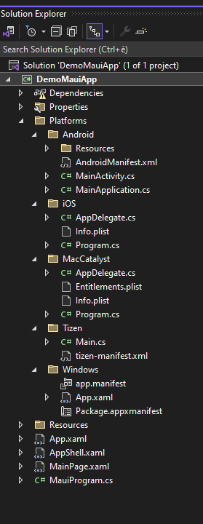
Platform Integration
Platform Specific folders hold platform specific resources, configuration, startup logic, and platform code.

Slide 51
Multi-Targeted
<TargetFrameworks>
net8.0-android;net8.0-ios;net8.0-maccatalyst
</TargetFrameworks>
<!-- Display name -->
<ApplicationTitle>DemoMauiApp</ApplicationTitle>
App Identifier -->
<ApplicationId>com.companyname.demomauiapp</ApplicationId>
<!-- Versions -->
<ApplicationVersion>1.0</ApplicationVersion>

Slide 52
Conditionally Compile
#if ANDROID
var button = new Android.Widget.Button(context);
#elif IOS
var button = new UIKit.UIButton();
#endif

Slide 53
.NET MAUI Startup
public static MauiApp CreateMauiApp()
{
var builder = MauiApp.CreateBuilder();
builder
.UseMauiApp<App>()
.ConfigureFonts(fonts =>
{
fonts.AddFont("OpenSans-Regular.ttf", "OpenSansRegular");
fonts.AddFont("OpenSans-Semibold.ttf", "OpenSansSemibold");
});
return builder.Build();
}

Slide 54
.NET MAUI Startup
public static MauiApp CreateMauiApp()
{
var builder = MauiApp.CreateBuilder();
builder
.UseMauiApp<App>()
.ConfigureFonts(fonts =>
{
fonts.AddFont("OpenSans-Regular.ttf", "OpenSansRegular");
fonts.AddFont("OpenSans-Semibold.ttf", "OpenSansSemibold");
});
builder.Services.AddSingleton<MyService>();
#if DEBUG
builder.Logging.AddDebug();
#endif
return builder.Build();
}

Slide 55
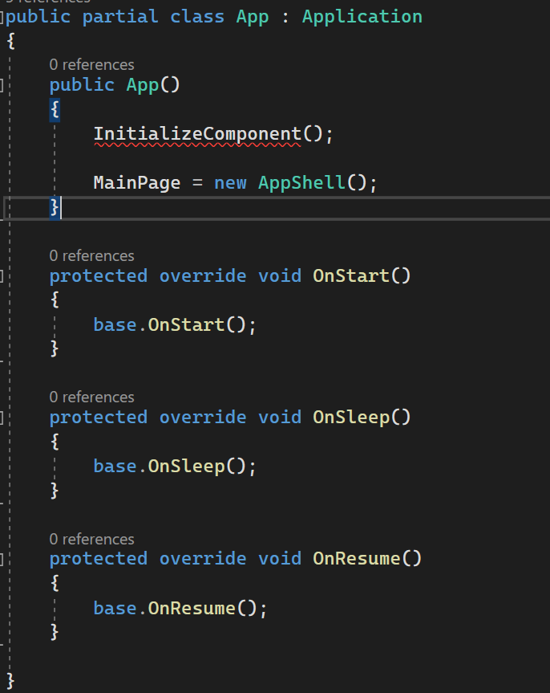

.NET MAUI Application
Application lifecycle:
OnStart
OnSleep
OnResume

Slide 56
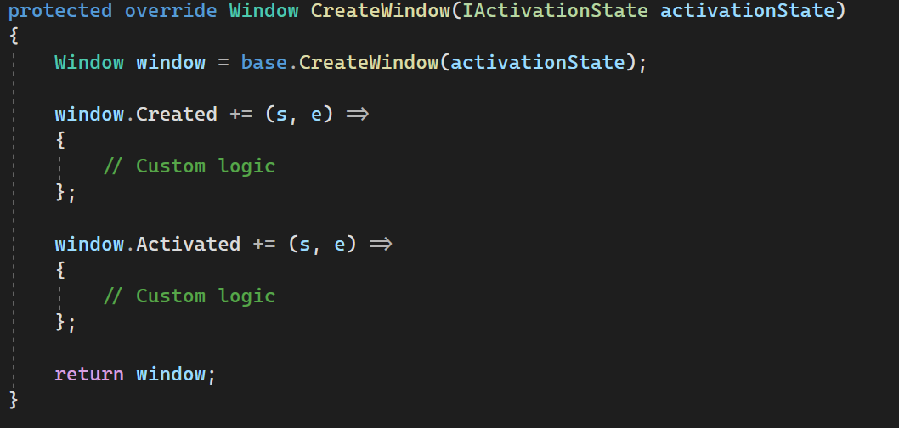
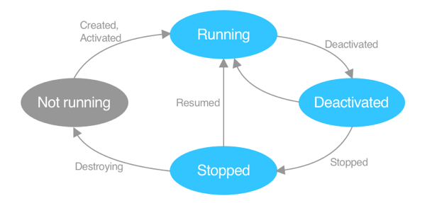
.NET MAUI Application Lifecycle
Windows lifecycle:
Created
Activated
Deactivated
Stopped
Resumed
Destroying

Slide 57
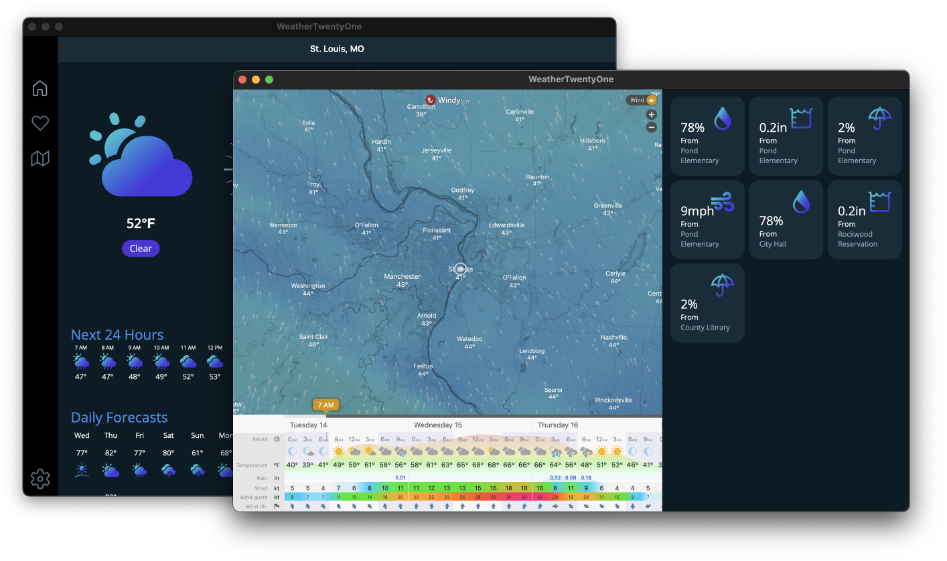
Multi-window
var secondWindow = new Window { Page = new MySecondPage { // ... } };
Application.Current.OpenWindow(secondWindow);

Slide 58
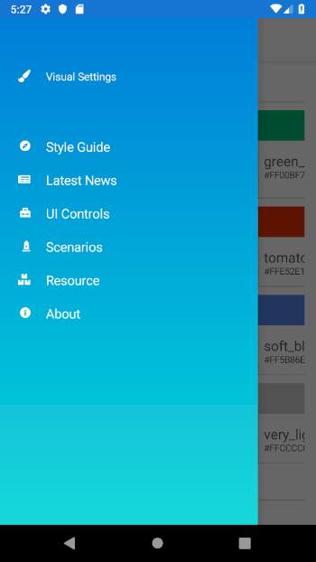
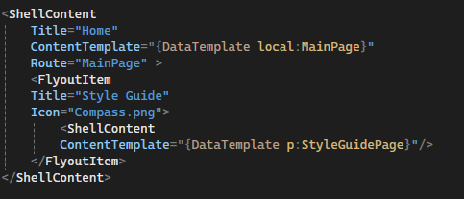
Shell

Slide 59
Pages
ContentPage
Single screen of content
ContentPage holds one visual element
Content property
Control

Slide 60
Layout
Layouts handle child elements
Layouts include:
Grid
StackLayout
RelativeLayout
FlexLayout
& more
ContentPage
Content property
Layout
Layout
Children
Control
Control
Control
Control

Slide 61
Providing Behavior
Controls expose properties to alter visualization
var entry = new Entry { Placeholder = "Enter text", Keyboard = Keyboard.Email }; entry.TextChanged += (sender, e) => { // Input changed };
Controls expose events to provide interactive behavior

Slide 62
Coding
Time

Slide 63
https://github.com/codrinamerigo/DCCDemoMauiApp

Slide 64
MVVM & Data Binding

Slide 65
Modern Patterns
MVVM
Provide Values
View Bound to ViewModel
Model
ViewModel
View
Updates
Triggers Commands
MVU
ReactiveUI
Generated View
View
User Action
Model
Message
Reducer
New Model
Notes:
As you know Xamarin.Forms support MVVM (model-view-viewmodel) and RxUI (ReactiveUI) patterns. In addition to those, .NET MAUI will support MVU (model-view-update) and Blazor development patterns.
MVU This pattern provides a unified way to build cross-platform native front ends from a single code base. It also allows us to write UI code and logic in C# as shown below.
MVVM(Model View ViewModel) MVVM is the default built in architecture design pattern in the xamarin.Forms framework. The UI in MVVM is Mutable. Which make managing the state difficult and cause many issues. It consists of three parts. • Model- The definition of data • View- The User Interface for user to interact with the app • ViewModel- The ViewModel stays in between the View and Model. It have all the business logic and presentation logic. The MVVM enable to keep the UI code, Logic and Data separate. Thus it help in easy maintenance. You can learn more about MVVM at https://docs.microsoft.com/en-us/xamarin/xamarin-forms/enterprise-application-patterns/mvvm
ReactiveUI ReactiveUI is a framework which enables use of Reactive Programming over MVVM design pattern. Reactive Programming is done using Reactive Extensions. The Reactive Extensions (Rx) is a library for composing asynchronous and event-based programs using observable sequences and LINQ-style query operators. ReactiveUI make mutable state managable. DynamicData is part of ReactiveUI which makes managing any kind of data very efficient. The definition given at reactiveui.net is “An advanced, composable, functional reactive model-view-viewmodel framework for all .NET platforms!”. The Reactive code is concise and testable. You can learn about it at https://www.reactiveui.net/
MVU( Model View Update) MVU is a Functional Reactive Programming, architecture design pattern. In MVU UI is immutable. So you have to rebuild your UI, every time you wanted to update a property. Immutability is the property of Funtional Programming. C# does support Functional programming paradigm. C# is taking it further with C# 9 and dot net 5 release in November 2020. In this setup the UI and business login is written in same language e.g C#. The flow of data is unidirectional. It is Good fit for hot reload of the application. You don’t need to learn XAML for developing UI instead develop complete application in one language.
MVU This pattern provides a unified way to build cross-platform native front ends from a single code base. It also allows us to write UI code and logic in C# as shown below.

Slide 66
Model-View-ViewModel
Model
ViewModel
View
Data
Data
Events
Business Logic
Data objects
What to display
Flow of interaction
How to display information

Slide 67
Model-View-ViewModel
Data
View
ViewModel
Model
Events
.NET MAUI
Data Binding

Slide 68
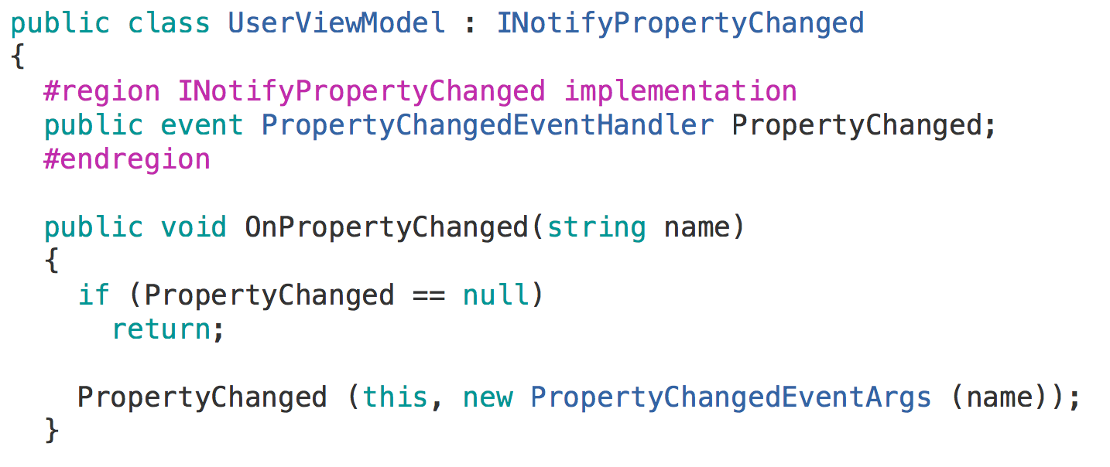
Data Binding

Slide 69
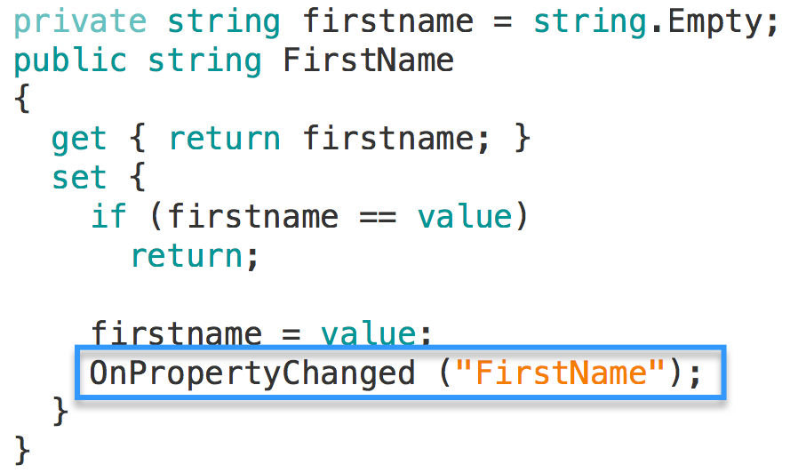
Data Binding

Slide 70
Data Binding

Slide 71
Data Binding

Slide 72
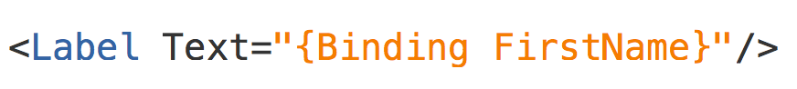
Data Binding – XAML

Slide 73
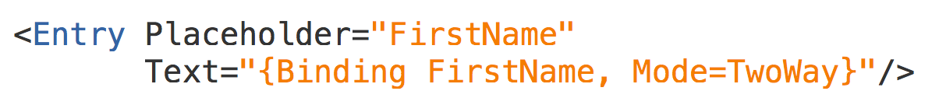
Data Binding – XAML

Slide 74

Event Handling
UI raises events to notify code about user activity
Clicked
ItemSelected
…
The downside is that these events must be handled in the code behind file
Edit
Clicked
public MainPage() { ... Button editButton = ...; editButton.Clicked += OnClick; } void OnClick (object sender, EventArgs e) { ... }

Slide 75
Commands
Microsoft defined the ICommand interface to provide a commanding abstraction for their XAML frameworks
Edit
public interface ICommand { event EventHandler CanExecuteChanged; bool CanExecute(object parameter); void Execute(object parameter); }
Command
CanExecute?
Execute(…)
Can provide an optional parameter (often null) for the command to work with for context

Slide 76
ICommand
ICommand has three required members you must implement
CanExecute is called to determine whether the command is valid, this can enable / disable the control which is bound to the command
public interface ICommand { bool CanExecute(object parameter); void Execute(object parameter); event EventHandler CanExecuteChanged; }

Slide 77
ICommand
ICommand has three required members you must implement
Execute is called to actually run the logic associated with the command when the control is activated – it will only be called if CanExecute returned true
public interface ICommand { bool CanExecute(object parameter); void Execute(object parameter); event EventHandler CanExecuteChanged; }

Slide 78
ICommand
ICommand has three required members you must implement
CanExecuteChanged is an event which the binding will subscribe to, the ViewModel should raise this event when the validity of the command changes
public interface ICommand { bool CanExecute(object parameter); void Execute(object parameter); event EventHandler CanExecuteChanged; }
The binding will then call CanExecute and enable / disable the UI in response

Slide 79




Commands in .NET MAUI
.NET MAUI controls expose a Command property for the main action of a control
Menu
Button
ToolbarItem
TextCell

Slide 80
Commands in .NET MAUI
.NET MAUI controls expose a Command property for the main action of a control
public ICommand GiveBonus { get; }
<Button Text="Give Bonus" Command="{Binding GiveBonus}" />
Can data bind a property of type ICommand to the Command property

Slide 81
Gesture-based commands
.NET MAUI also includes a TapGestureRecognizer which can provide a command interaction for other controls or visuals
<Image Source="IDareYouToTapMe.jpg"> <Image.GestureRecognizers> <TapGestureRecognizer Command="{Binding BeBraveCommand}" CommandParameter="TheyTookTheDare!" /> </Image.GestureRecognizers> </Image>
CommandParameter property supplies the command's parameter – in this case as a string

Slide 82
Using delegate commands
Command<T> and Command provides mechanism to centralize the logic for the commands into the VM
public class EmployeeViewModel : INotifyPropertyChanged { public ICommand GiveBonus { get; private set; } public EmployeeViewModel(Employee model) { GiveBonus = new Command(OnGiveBonus, OnCanGiveBonus); }
void OnGiveBonus() { ... }
bool OnCanGiveBonus() { return ... }
}

Slide 83
Compiled Bindings
.NET MAUI controls expose a x:DataType property that enables compile time checks and optimizations.
<ContentPage x:DataType="viewmodel:EmployeeViewModel">
<Button Text="Give Bonus" Command="{Binding GiveBonus}" />
</ContentPage >

Slide 84
Coding
Time

Slide 85
Coffee Break

Slide 86
.NET MAUI NAVIGATION

Slide 87
Basic Navigation
Root Page:
NavigationPage – Gives each page an INavigation
Standard Navigation
Navigation.PushAsync(page: nextPage);
Navigation.PopAsync();
Modal Navigation
Navigation.PushModalAsync(page: modalPage);
Navigation.PopModalAsync();

Slide 88
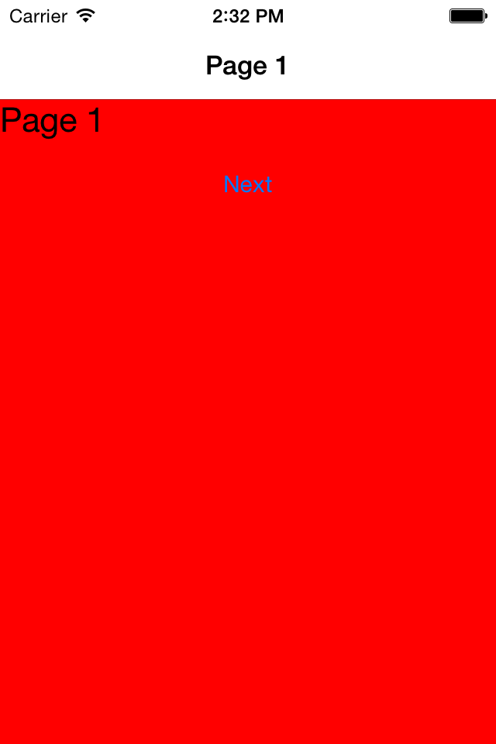
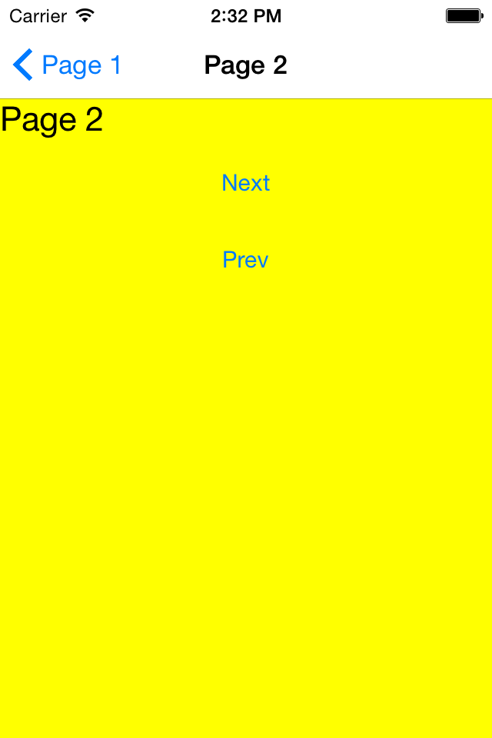
PushAsync/PopAsync

Slide 89
Advanced Navigation
Editing of stack beyond push/pop
Remove Page
InsertPageBefore
NavigationStack[]
Disable animations

Slide 90
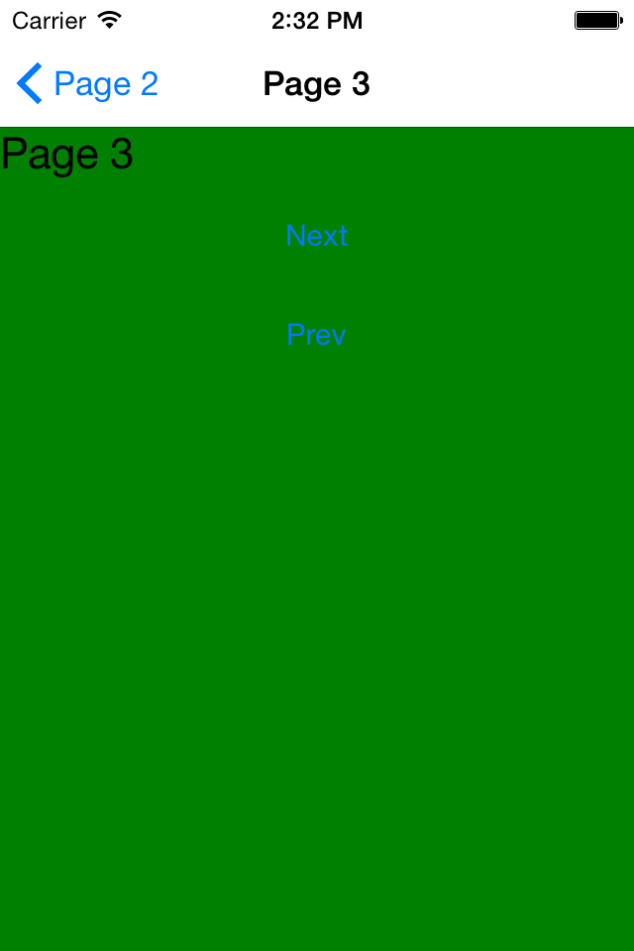
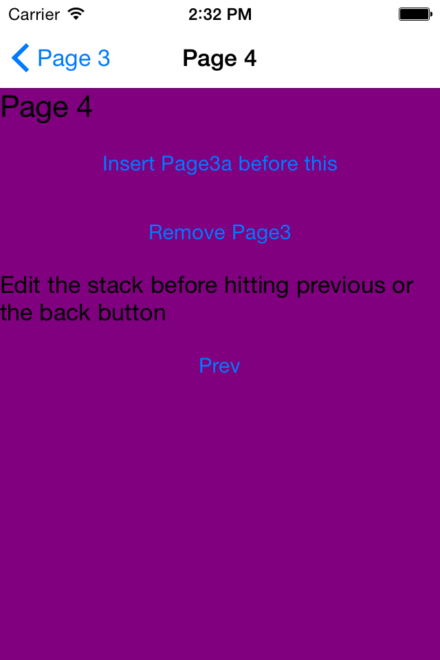
Push/Pop
RemovePage

Slide 91
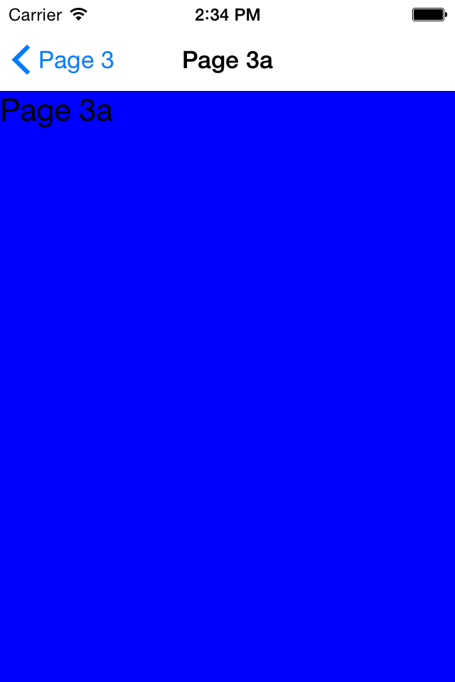
Push/Pop
InsertPageBefore

Slide 92
.NET MAUI Shell

Slide 93
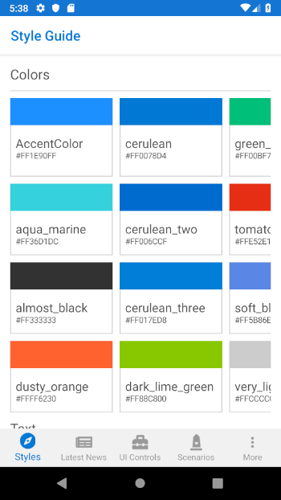
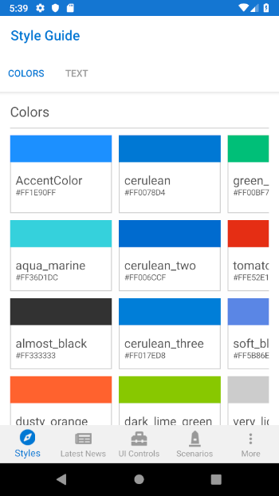
Shell

Slide 94
<Shell>
<FlyoutItem
Title="Style Guide"
Icon="Compass.png">
<ShellContent
ContentTemplate="{DataTemplate p:StyleGuidePage}"/>
</FlyoutItem>
</Shell>
Shell

Slide 95
<Shell>
<TabBar>
<Tab Title="Styles" Icon="Compass.png">
<ShellContent
ContentTemplate="{DataTemplate p:StyleGuidePage}"/>
</Tab>
</TabBar>
</Shell>
Shell

Slide 96
<Shell>
<TabBar>
<Tab
Title="Style Guide"
Icon="Compass.png">
<ShellContent
Title="Colors"
ContentTemplate="{DataTemplate p:ColorsPage}"/>
<ShellContent
Title="Text"
ContentTemplate="{DataTemplate p:TextPage}"/>
</Tab>
</TabBar>
</Shell>
Shell

Slide 97
CityListPage
CityDetailPage
Shell.Current.GoToAsync("detail");
Shell Navigation Service

Slide 98
CityListPage
CityDetailPage
Shell.Current.GoToAsync("..");
Shell Navigation Service

Slide 99
CityListPage
CityDetailPage
Shell.Current
.GoToAsync($"detail?id={city.id}");
Shell Navigation Service

Slide 100
CityListPage
CityDetailPage
[QueryProperty("CityId", "id")]
public partial class CityDetailPage : ContentPage
{
public CityDetailPage()
{
InitializeComponent();
}
public string CityId
{
set
{
// do something with the Id
}
}
}
Shell Navigation Service

Slide 101
CityListPage
CityDetailPage
var city = new City("Cleveland");
Shell.Current.GoToAsync("detail",
new Dictionary<string, object>
{
{"City", city}
});
Shell Navigation Service – Pass Objects

Slide 102
CityListPage
CityDetailPage
[QueryProperty("City", "City")]
public partial class CityDetailPage : ContentPage
{
public CityDetailPage()
{
InitializeComponent();
}
public City City
{
get; set;
}
}
Shell Navigation Service – Pass Objects

Slide 103
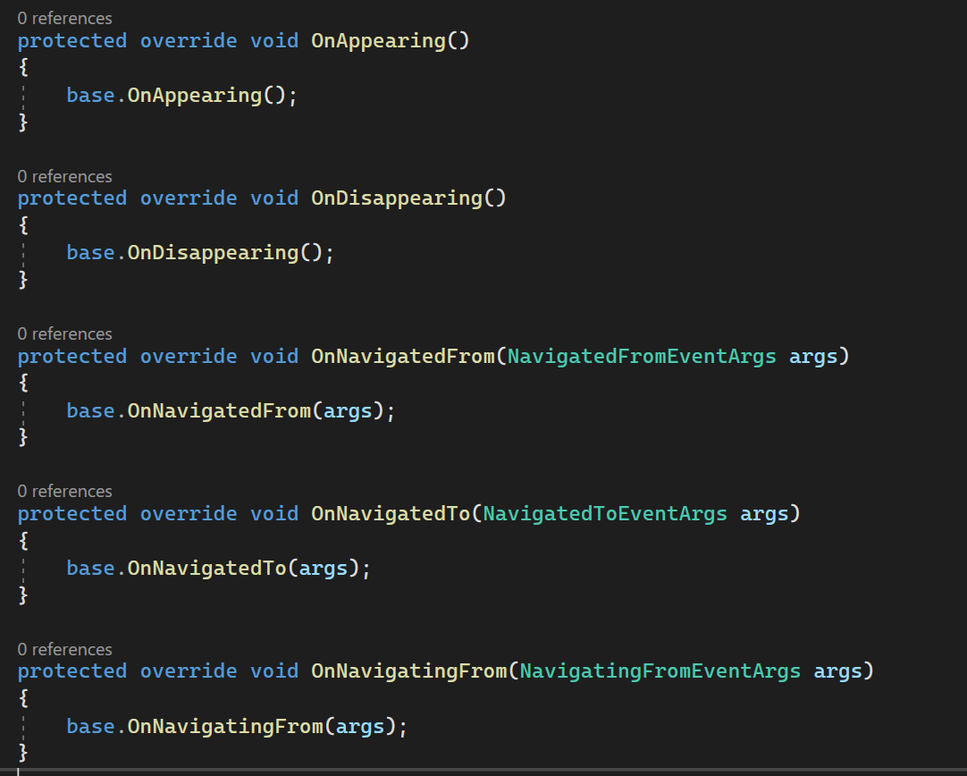
.NET MAUI Page Lifecycle
Legacy Page lifecycle events:
OnAppearing
OnDisappearing
Modern Navigation lifecycle events:
OnNavigatedTo
OnNavigatingFrom
OnNavigatedFrom

Slide 104
Platform Specifics

Slide 105
Shared C# Backend

Slide 106
Platform Specific Code
UI+APIs
UI + APIs
UI + APIs
Battery
GPS
Lights
Notifications
Settings
Text To Speech
Battery
GPS
Lights
Notifications
Settings
Text To Speech
Battery
GPS
Lights
Notifications
Settings
Text To Speech

Slide 107
Speak(“Hello World”);
AVSpeechSynthesizer
TextToSpeech
SpeechSynthesizer

Slide 108
Common Interface
ITextToSpeech
public interface ITextToSpeech
{
void Speak (string text);
}

Slide 109
Text To Speech
AVSpeechSynthesizer
public void Speak (string text)
{
var speechSynthesizer = new AVSpeechSynthesizer ();
var speechUtterance = new AVSpeechUtterance (text)
{
Rate = AVSpeechUtterance.MaximumSpeechRate/4,
Voice = AVSpeechSynthesisVoice.FromLanguage ("en-US"),
Volume = 0.5f,
PitchMultiplier = 1.0f
};
speechSynthesizer.SpeakUtterance (speechUtterance);
}

Slide 110
Text To Speech
TextToSpeech
TextToSpeech speaker;
string toSpeak;
public void Speak (string text)
{
toSpeak = text;
if (speaker == null)
{
speaker = new TextToSpeech (ctx, this);
}
else
{
var p = new Dictionary<string,string> ();
speaker.Speak (toSpeak, QueueMode.Flush, p);
}
}
public void OnInit (OperationResult status)
{
//… more stuff
}
AVSpeechSynthesizer

Slide 111
Text To Speech
SpeechSynthesizer
public async void Speak(string text)
{
SpeechSynthesizer synth = new SpeechSynthesizer();
await synth.SpeakTextAsync(text);
}

Slide 112
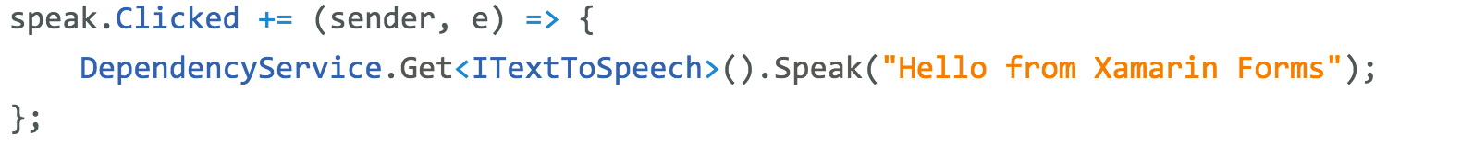
Dependency Service

Slide 113
Built-in IoC/DI
builder.Services.AddSingleton<ITextToSpeech, TextToSpeechImplementation>();
ITextToSpeech tts;
public MyViewModel(ITextToSpeech tts)
{
this.tts = tts;
}
void Speak()
{
tts.Speak(“Hello World”);
}

Slide 114
Common API

Slide 115
Maui.Essentials
Sms
Secure Settings
Preferences
Flashlight
Clipboard
Gyroscope
Magnetometer
Geolocation
Phone Dialer
Device Display Info
Email
Device Info
Battery
Compass
Accelerometer
Screen Lock
Data Transfer
Text to Speech
Geocoding
File System
Connectivity
Vibration

Slide 116
CollectionView & Beyond

Slide 117
CollectionView
CollectionView is a view for presenting lists of data using different layout specifications. It aims to provide a more flexible, and performant alternative to ListView.

Slide 118
CollectionView vs ListView
CollectionView has a flexible layout model, which allows data to be presented vertically or horizontally, in a list or a grid.
CollectionView supports single and multiple selection.
CollectionView has no concept of cells. Instead, a data template is used to define the appearance of each item of data in the list.
CollectionView automatically utilizes the virtualization provided by the underlying native controls.
CollectionView reduces the API surface of ListView. Many properties and events from ListView are not present in CollectionView.
CollectionView does not include built-in separators.
CollectionView will throw an exception if its ItemsSource is updated off the UI thread.

Slide 119
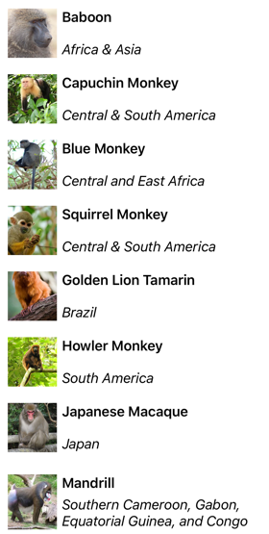
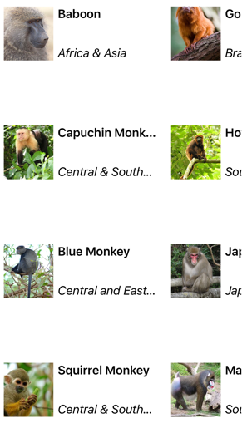
Layouts
List
Grids
<CollectionView.ItemsLayout>
<GridItemsLayout Orientation="Horizontal" Span="3"/>
</CollectionView.ItemsLayout>

Slide 120
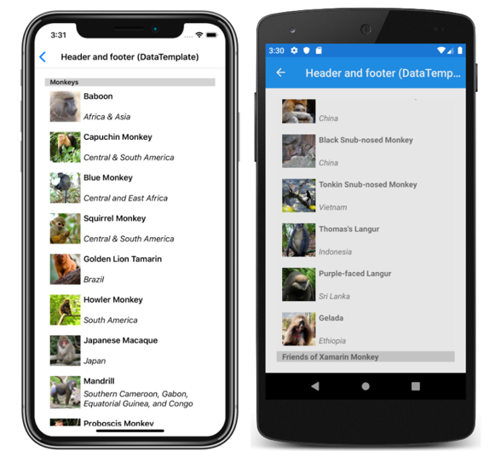
Headers & Footers

Slide 121
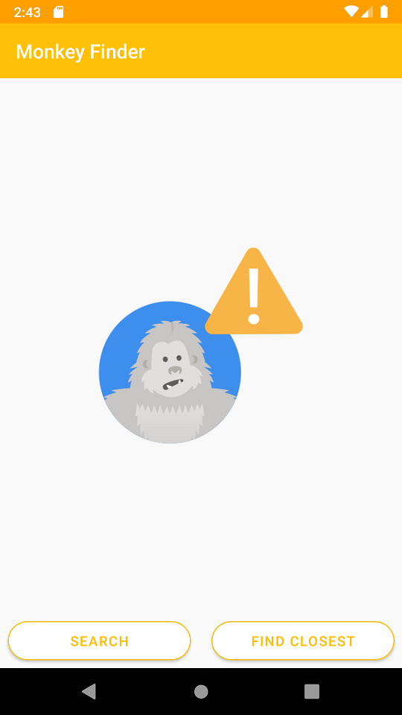
EmptyView
<CollectionView.EmptyView>
<StackLayout Padding="100">
<Image
HorizontalOptions="CenterAndExpand"
Source="nodata.png"
VerticalOptions="CenterAndExpand" />
</StackLayout>
</CollectionView.EmptyView>

Slide 122
Grouping
public class PodcastGroup : List<Podcast>
{
public string Name { get; private set; }
public PodcastGroup(string name, List<Podcast> podcasts)
: base(podcasts)
{
Name = name;
}
}
List<PodcastGroup> Podcasts { get; private set; }

Slide 123
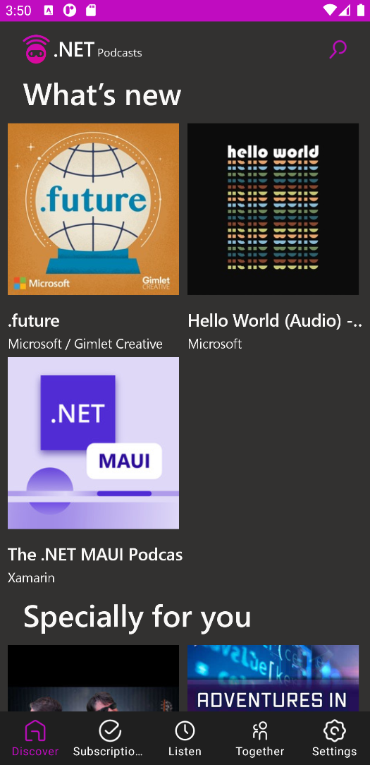
Grouping
<CollectionView ItemsSource="{Binding Podcasts}"
IsGrouped="true">
<CollectionView.GroupHeaderTemplate>
<DataTemplate>
<Label Text="{Binding Name}"
BackgroundColor="LightGray"
FontSize="Large"
FontAttributes="Bold" />
</DataTemplate>
</CollectionView.GroupHeaderTemplate>
</CollectionView>

Slide 124
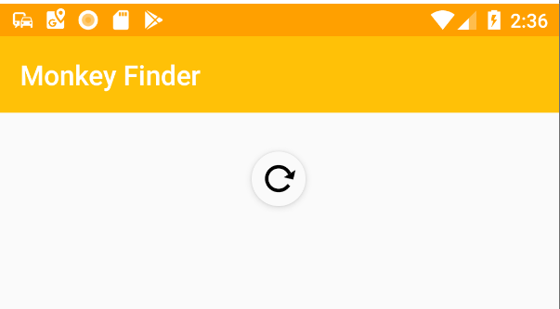
Pull-to-Refresh

Slide 125
public class MyViewModel : ObservableObject {
[ObservableProperty] private bool isBusy;
[ObservableProperty] private bool isRefreshing;
[ICommand] async Task Refresh() { if (IsBusy) return; IsBusy = true;
//do stuff IsRefreshing = false;
IsBusy = true; } }

Slide 126
ListView Support
<ListView x:Name="listView" ItemsSource="{Binding Items}" HasUnevenRows="True" IsPullToRefreshEnabled="True" RefreshCommand="{Binding RefreshCommand}" IsRefreshing="{Binding IsBusy}">

Slide 127
ListView API
//Enable/Disable all pull to refresh public bool IsPullToRefreshEnabled { get; set; } = false;
//Is the spinner currently shown public bool IsRefreshing { get; set; } = false;
//The method/command to trigger when pulled public ICommand RefreshCommand { get; set; } = null;
//Manual Events to trigger/subscribe public void BeginRefresh (); public void EndRefresh ();
public event EventHandler Refreshing;

Slide 128
RefreshView
<RefreshView Command="{Binding RefreshCommand}" IsRefreshing="{Binding IsRefreshing}">
<CollectionView ItemsSource="{Binding Items}">
…
</CollectionView>
</RefreshView>

Slide 129
RefreshView API
//Enable/Disable all pull to refresh public bool IsEnabled { get; set; } = false;
//Is the spinner currently shown public bool IsRefreshing { get; set; } = false;
//The method/command to trigger when pulled public ICommand Command { get; set; } = null;
//Manual Events to /subscribe public event EventHandler Refreshing;

Slide 130
NET MAUI App Themes & Resources

Slide 131
Objectives
Avoid duplicate XAML with Resources
Create consistent UI with Styles
Makes Resources & Styles available across app
Enable Light & Dark Theme modes

Slide 132
Motivation
Duplicate XAML values are error prone and difficult to maintain
<StackLayout BackgroundColor="#FFFFFF"> <Label TextColor="#00FF00" FontSize="16.5" ... /> <Entry BackgroundColor="#FFFFFF" ... /> <BoxView BackgroundColor="#00FF00" ... /> <Button BackgroundColor="#00FF00" FontSize="16.5" ... />
</StackLayout>
Common to use the same colors and sizes across the UI

Slide 133
What is a Resource?
A Resource is an object that can be used in multiple places in your UI
Define one copy
as a Resource
#00FF00
16.5
<Label TextColor=" " FontSize=" " ... />
<Button BackgroundColor=" " FontSize=" " ... />
Apply Resources throughout your UI

Slide 134
What is a ResourceDictionary?
ResourceDictionary is a key/value dictionary that is customized for use with UI Resources
public sealed class ResourceDictionary : ...
{ ... public object this[string index] { get; set; }
public void Add(string key, object value);
public void Add(Style implicitStyle); }
Mostly has
standard
dictionary
operations
Some added UI-specific functionality

Slide 135
Page-level Resources
Every page can have a resource dictionary, must be set in code or XAML
<ContentPage ...>
<ContentPage.Resources> <ResourceDictionary>
... </ResourceDictionary> </ContentPage.Resources> </ContentPage>
Assign the dictionary
you create to the page's
Resources property
You must create
the dictionary

Slide 136

Creating Resources
Resources created in XAML must use the XAML-language keyword x:Key to set the key
<ContentPage ...> <ContentPage.Resources> <ResourceDictionary> <Thickness x:Key="myKey">10,20,40,80</Thickness> </ResourceDictionary> </ContentPage.Resources> </ContentPage>
Create inside
the page's
dictionary
Value
Key
Choose Resource names based on use, not value; e.g. use bgColor, not redColor.

Slide 137
Using static Resources
The StaticResource markup extension retrieves a resource, the value is applied once when the target object is created
<ContentPage ...> <ContentPage.Resources> <ResourceDictionary> <Thickness x:Key="myKey">10,20,40,80</Thickness> </ResourceDictionary> </ContentPage.Resources>
<StackLayout Padding="{StaticResource myKey}">
... </StackLayout> </ContentPage>
Define
Use

Slide 138
XAML intrinsic types
The XAML spec defines many types you can use for XAML Resources
<ResourceDictionary> <x:String x:Key="...">Hello</x:String> <x:Char x:Key="...">X</x:Char> <x:Single x:Key="...">31.4</x:Single> <x:Double x:Key="...">27.1</x:Double> <x:Byte x:Key="...">8</x:Byte> <x:Int16 x:Key="...">16</x:Int16> <x:Int32 x:Key="...">32</x:Int32> <x:Int64 x:Key="...">64</x:Int64> <x:Decimal x:Key="...">12345</x:Decimal> <x:TimeSpan x:Key="...">1.23:5959</x:TimeSpan> <x:Boolean x:Key="...">True</x:Boolean>
</ResourceDictionary>
String and
Double are
useful since
many UI
properties use
those types

Slide 139
Platform dependencies
Can use OnPlatform objects in your resource dictionaries to handle platform-specific values
<ResourceDictionary> <OnPlatform x:Key="textColor" x:TypeArguments="Color" iOS="Red" Android="Blue" Windows="Green" /> </ResourceDictionary>
<Label TextColor="{StaticResource textColor}" ... />

Slide 140
How to update Resources
Can update resource values from code, useful when you download new values or let the user select preferred colors, font sizes, etc.
Define a
default
in XAML
<ResourceDictionary> <Color x:Key="bg">Blue</Color> </ResourceDictionary>
void OnChangeColor()
{
this.Resources["bg"] = Color.Green; }
Update
to new
value

Slide 141
Using dynamic Resources
The DynamicResource markup extension retrieves a resource when the target object is created and updates it as the value changes
<ResourceDictionary> <Color x:Key="bg">Blue</Color> </ResourceDictionary>
<StackLayout BackgroundColor="{DynamicResource bg}">
... </StackLayout>
BackgroundColor
set to Blue initially
void OnChangeColor()
{
this.Resources["bg"] = Color.Green; }
BackgroundColor
changes to Green

Slide 142
Applying Resources in code
Resources can be set in code using SetDynamicResource, allows logic to apply different resources based on runtime knowledge
var name = new Label { Text = "Name" };
name.SetDynamicResource(Label.TextColorProperty, "hlColor");
The BindableProperty to assign
The Resource key to apply

Slide 143
Styles

Slide 144
Motivation [repeated code]
Resources let you avoid duplicate values, but you still have to set each property individually which creates clutter and yields repeated code
<Button
BackgroundColor="{StaticResource highlightColor}" BorderColor ="{StaticResource edgeColor}" BorderRadius ="{StaticResource edgeRadius}" BorderWidth ="{StaticResource edgeSize}" TextColor ="{StaticResource textColor}" Text ="OK" />
OK
The property
settings must
be repeated
on each view
<Button
BackgroundColor="{StaticResource highlightColor}" BorderColor ="{StaticResource edgeColor}" BorderRadius ="{StaticResource edgeRadius}" BorderWidth ="{StaticResource edgeSize}" TextColor ="{StaticResource textColor}" Text ="Cancel" />
Cancel

Slide 145
Motivation [efficiency]
Resource lookup can increase the startup time of your app since the lookup takes longer than assigning a literal value
<Button
TextColor="{StaticResource textColor}"
... />
<Button
TextColor="White"
... />
Slower
Faster

Slide 146
What is a Setter?
A Setter is a container for a property→value pair
<Setter Property="TextColor" Value="White" />
A bindable
property
A value appropriate
for the property

Slide 147
What is a Style?
A Style is a collection of setters for a particular type of view
TargetType must be set (or runtime exception)
<Style TargetType="Button"> <Setter Property="BackgroundColor" Value="#2A84D3" /> <Setter Property="BorderColor" Value="#1C5F9B" /> <Setter Property="BorderRadius" Value="10" /> <Setter Property="BorderWidth" Value="3" /> <Setter Property="TextColor" Value="White" />
</Style>
The properties must be members of the
TargetType class (or runtime exception)

Slide 148
Styles as Resources
Styles are shareable, so they are generally defined as Resources
<ContentPage.Resources> <ResourceDictionary>
<Style x:Key="MyButtonStyle" TargetType="Button"> ...
</Style> </ResourceDictionary> </ContentPage.Resources>
Define in a
dictionary

Slide 149
Using a Style
Styles are set on a control through the Style property, this applies all the setters in the style to that control
<Button Text="OK" Style="{StaticResource MyButtonStyle}" />
<Button Text="Cancel" Style="{StaticResource MyButtonStyle}" />
The Style property is defined
in the VisualElement base
class so it is available in all views

Slide 150
Combining Styles and Resources
Can use a resource as the Value for a setter, this lets it share a value with other styles
<Color x:Key="bgColor">White</Color> <Color x:Key="fgColor">Black</Color>
<Style TargetType="Button" x:Key="AllButtons"> <Setter Property="BackgroundColor" Value="{StaticResource bgColor}" />
<Setter Property="TextColor" Value="{DynamicResource fgColor}" />
... </Style>
Can use either static or dynamic lookup

Slide 151
Implicit Styles
Styles can be automatically applied to all controls of a target type by omitting x:Key and placing the style into an accessible dictionary
<ContentPage.Resources> <ResourceDictionary> <Style TargetType="Button"> <Setter Property="BackgroundColor" Value="Blue" /> <Setter Property="BorderColor" Value="Navy" />
... </Style> </ResourceDictionary>
</ContentPage.Resources>
The target type is still specified and is matched exactly,
this style will be applied to all buttons in this page

Slide 152
Overriding a setter
Styles provide the default values, explicit property values on the control are applied after the style and take precedence
<Style x:Key="MyButtonStyle" TargetType="Button"> <Setter Property="BackgroundColor" Value="Red" /> </Style>
<Button
Style="{StaticResource MyButtonStyle}"
BackgroundColor="Blue"
Text="Cancel" ... />
Cancel
Value set directly overrules the style value
Background is blue, not red

Slide 153
Ancestor targeting
A Style can target a base type of the object to which it is applied
This style targets VisualElement
<Style x:Key="MyVisualElementStyle" TargetType="VisualElement"> <Setter Property="BackgroundColor" Value="#2A84D3" /> </Style>
<Button Style="{StaticResource MyVisualElementStyle}" ... />
Can apply to a button since the Button
class is derived from VisualElement

Slide 154
Creating a Style in code
Styles can be created in code to allow runtime customizations
var s = new Style(typeof(Button)); s.Setters.Add(new Setter {Property = Button.BackgroundColorProperty, Value = Color.Red}); s.Setters.Add(new Setter {Property = Button.BorderRadiusProperty, Value = 4 });
Can then apply Style to a Button directly, or add it to the resources to apply in XAML

Slide 155
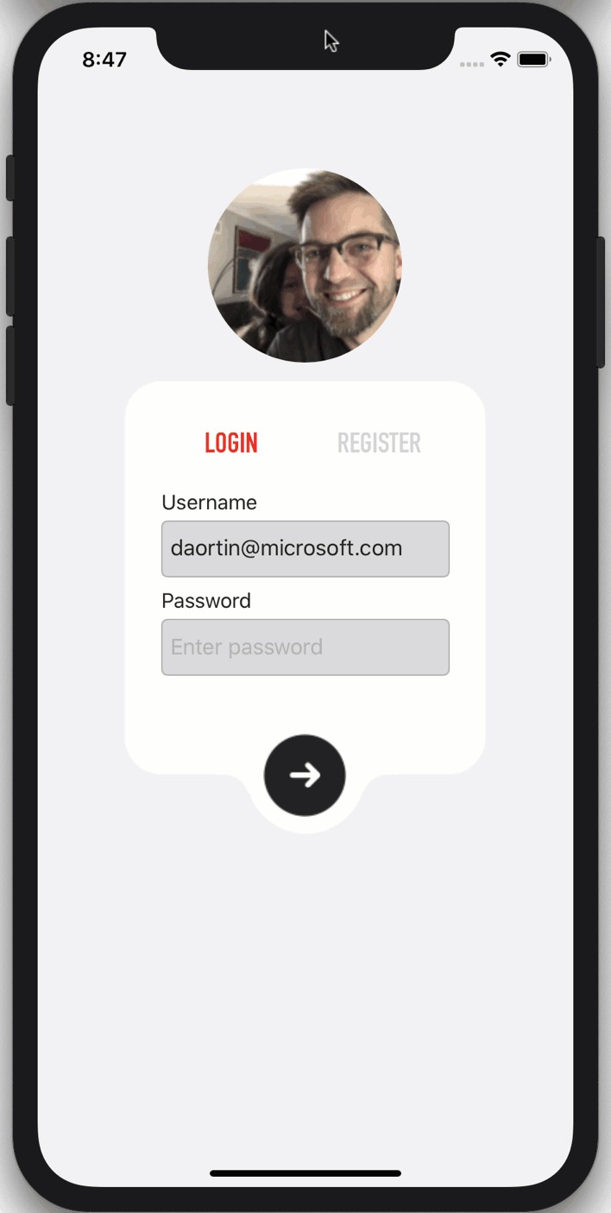
App Themes (Light & Dark Mode)

Slide 156
Using AppThemeBinding
The AppThemeBinding markup extension automatically adjusts the value based on the detected theme of the device
<ResourceDictionary> <Color x:Key="bgLight">White</Color> <Color x:Key="bgDark">Black</Color> </ResourceDictionary>
<Button BackgroundColor="{AppThemeBinding
Light={StaticResource bgLight},
Dark={StaticResource bgDark}}"/>
...

Slide 157
Using AppThemeBinding & Styles
You can also leverage Styles with AppThemeBinding
<ResourceDictionary> <Color x:Key="bgLight">White</Color> <Color x:Key="bgDark">Black</Color>
<Style x:Key="MyButtonStyle" TargetType="Button"> <Setter Property="BackgroundColor"
Value="{AppThemeBinding Light={StaticResource bgLight},
Dark={StaticResource bgDark}}"/>
</Style> </ResourceDictionary>
<Button Style="{StaticResource MyButtonStyle}">

Slide 158
Set Theme Manually
You can set the UserAppTheme to force to Light or Dark Mode
App.Current.UserAppTheme = AppTheme.Dark;

Slide 159
Publish your app

Slide 160
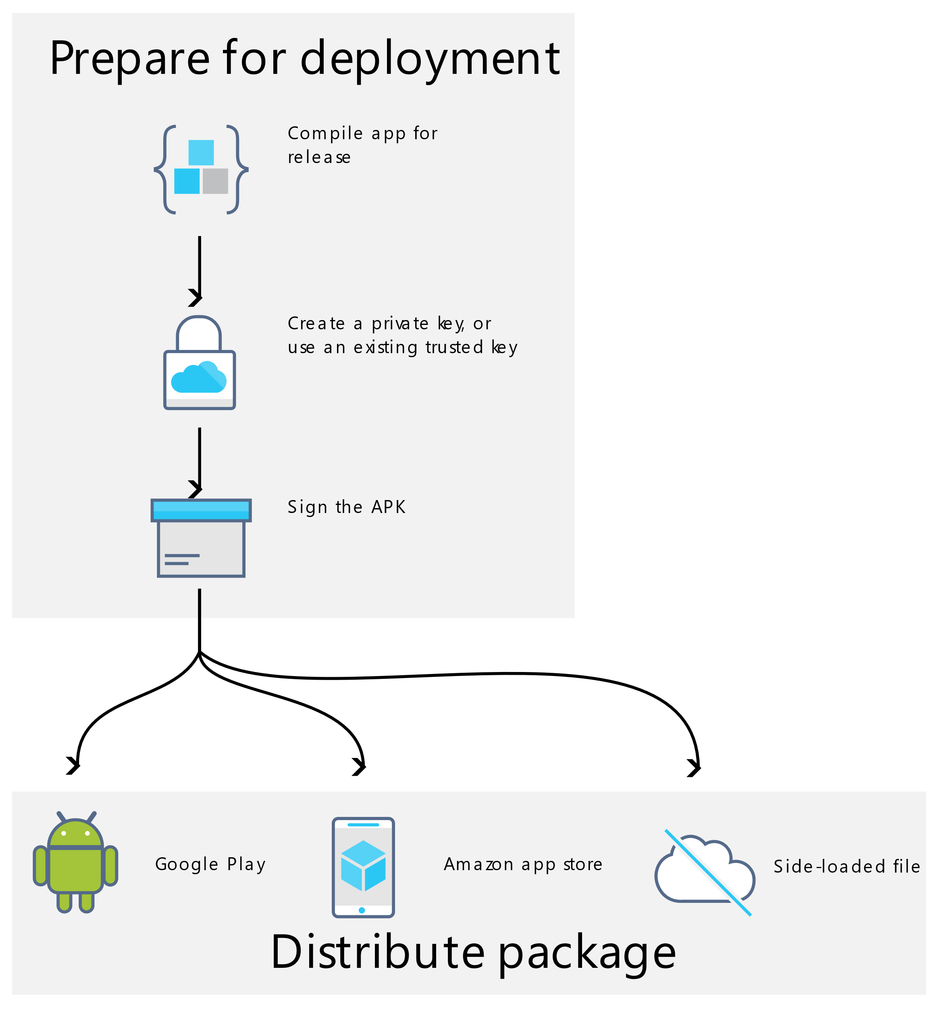

Ready for the stores

Slide 161
Questions Time
@_Codrina_

Slide 162
Thank you!
Add me on LinkedIn:
Follow me on X(twitter):
in/codrinamerigo/
@_Codrina_
This presentation is for educational purposes only.
Opinions or points of view expressed in this presentation represent the view of the speaker.
All trademarks, logos and brand names are the property of their respective owners.

